Slide 1
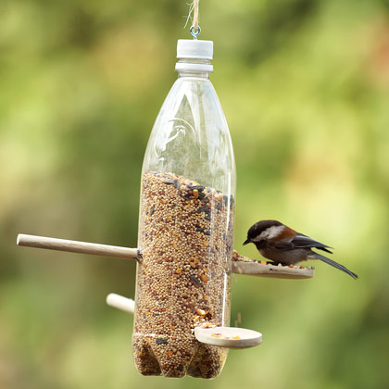
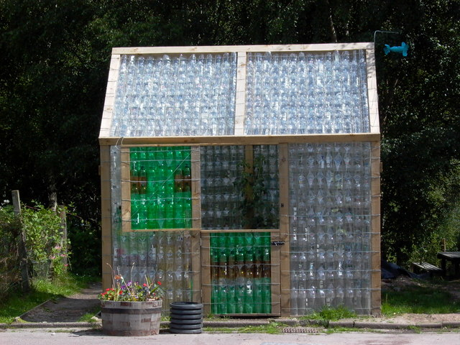
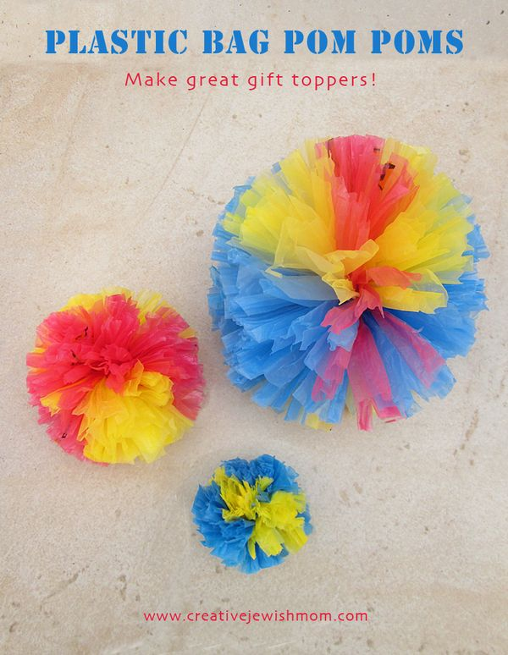
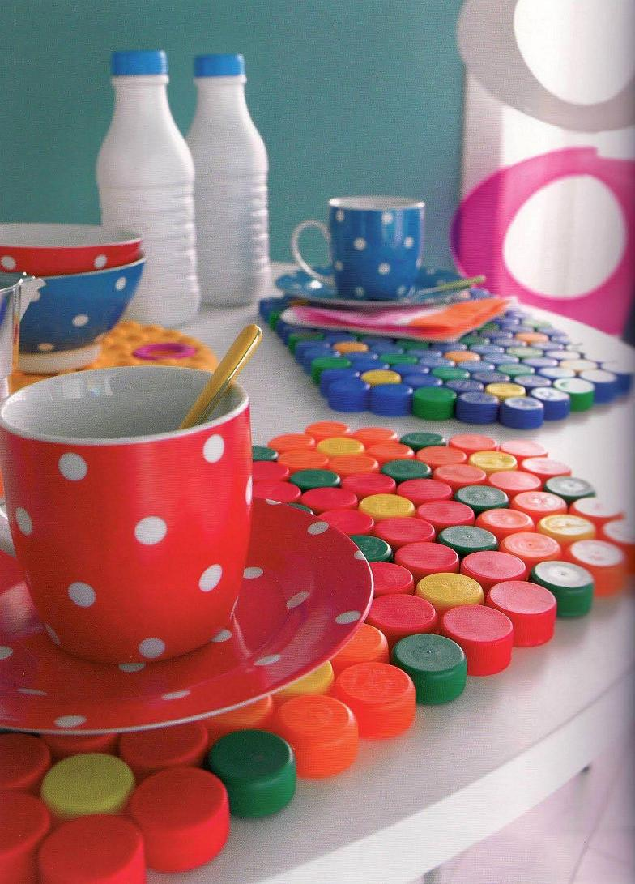
Geography Challenge
The Geography Department would like to challenge you to make something useful from materials that would otherwise be thrown away.
You can send a picture of your creation, write about it or create a video pitching it to us. Extra points will be awarded for ideas which help the planet.
Send your ideas to: h.coward@poolhayes.attrust.org.uk

