Slide 1


Slide 2


Tim Berners-Lee created the internet in 1989 and the world changed.

Slide 3
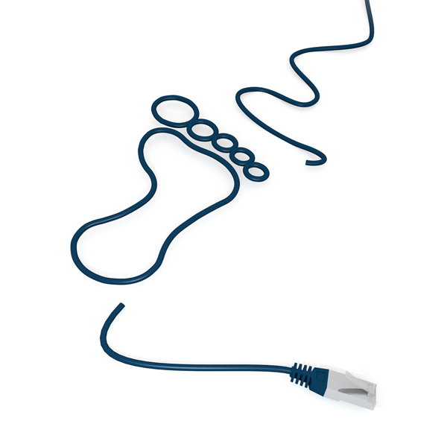
Keeping Safe Online
We are spending more time on the internet and social media especially during these tough times so it is important that we stay safe online
Notes:
Most of the school are familiar with the idea of carbon footprints, but you can explain the analogy that we leave digital footprints all over the internet and we have to be careful that what we leave is appropriate and positive as it will be there for years to come and could impact on job or college opportunities, future partners etc.
Although we don’t want to scare them, it is really important that they understand the impact of what is online, particularly with regard to inappropriate comments, pictures of themselves etc.
One of the most important messages is that if they receive any indecent images they are just as liable as the person sending the images, even if they didn’t ask for them or they are sent by a best friend or boy/girlfriend. They could be prosecuted.
Each student has an advice sheet they can write down information or advice on throughout the lessons, and they can then use this to complete the final competition activity or producing an acrostic giving internet safety advice.

Slide 4














What do you do online?

Slide 5

Online actions have offline consequences.

Slide 6





Friends and Chat…
In the online world you:
Are more likely to start talking to someone you don’t know and add anyone to your friend lists.
People aren’t always honest with who they are, their age or what they look like.
50%* young people find it easier being themselves on the internet than when they are face-to-face
Are more likely to say hurtful and upsetting things – it’s not always clear when something's a joke.
Can break down boundaries of place, time and cost.
In the real world:
Would you just start talking to a random person on the street?
You know who you are talking to
It’s hard to pretend to be something you’re not.
Its hard to say something nasty to someone's face.
You can tell from body language and the tone of voice how people intend comments to be taken.
(*EU Kids Online Survey – S Livingstone 2010)

Slide 7

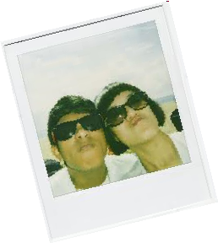
What you share…
In the real world would you:
Tell a complete stranger where you live, your full name, mobile number etc?
Would you want over 500 million people to see a photo of you and your friends?
Be happy if your friend shared a particularly unattractive photo of you with the whole school?
Want your employer/ university/ teacher/ family to see everything you get up to on the weekend?
In the online world you are:
Often sharing personal information with people you don’t know.
Posting photo’s and videos onto the biggest online billboards in the world
Rarely asking permission to upload pictures of your friends – what if they don’t want the image online?
If you don’t set your privacy settings – you never know who could see your content.
Able to be creative and share content with friends and family across the world.

Slide 8
What is Cyber Bullying?
Cyber bullying is any form of bullying which takes place online or through smartphones and tablets. This often occurs through:
Social networking sites
messaging apps
gaming sites
chat rooms such as Facebook, XBox Live, Instagram, YouTube, Snapchat

Slide 9
What does bullying Online look like?- Facebook
Pages that identify and shame private individuals,
Images altered to degrade private individuals,
Photos or videos of physical bullying posted to shame the victim,
Who has seen this?
Sharing personal information to blackmail or harass people and
Repeatedly targeting other people with unwanted friend requests or messages.
You can report bullying on Facebook using the report links which appear near the content itself, normally on a drop down arrow which gives you menu option to report the image, post or comment.

Slide 10
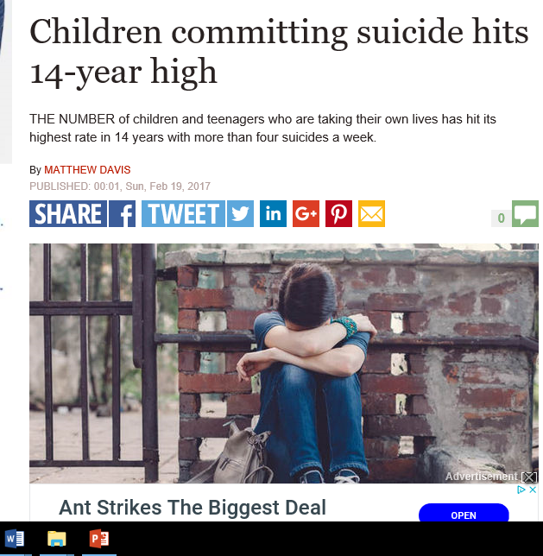
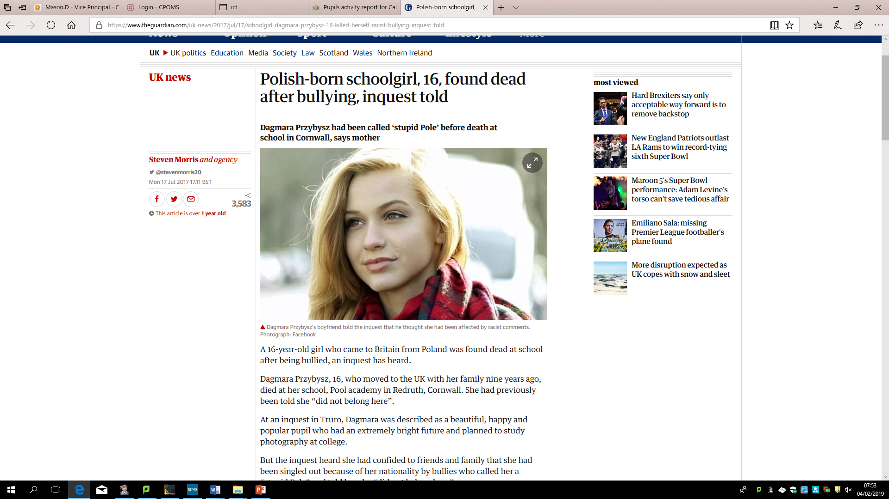
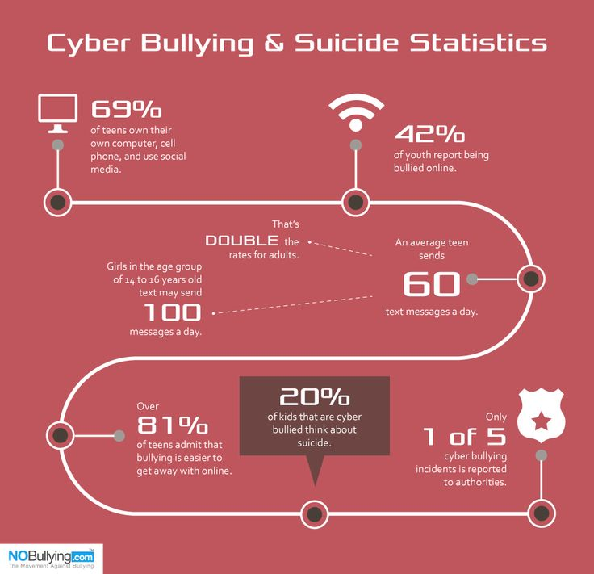
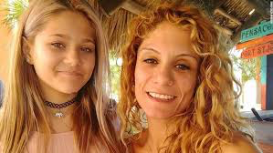
"Her actions consisted of starting rumors of the victim having sexually transmitted diseases, vulgar name-calling ... and threats to 'expose' personal and sensitive details of the victim's life."
Gabbie Green

Slide 11
Gossip, Rumours and fake news
Posting false and malicious things about people on the internet can be classed as ‘harassment’.
Bullying by spreading rumours and gossip is growing rapidly
Social networking sites and messaging apps can be seen by lots of people and these posts can go viral very fast and be shared by so many people within minutes in some cases.
From research, the most vicious gossip and rumours are often spread by people who were once your best friends
Keep secrets and personal information to yourself. Only tell people things if it wouldn't embarrass you if other people found out about them.

Slide 12


Slide 13


Fake news is a problem because it can make people believe things that are completely untrue.

Slide 14
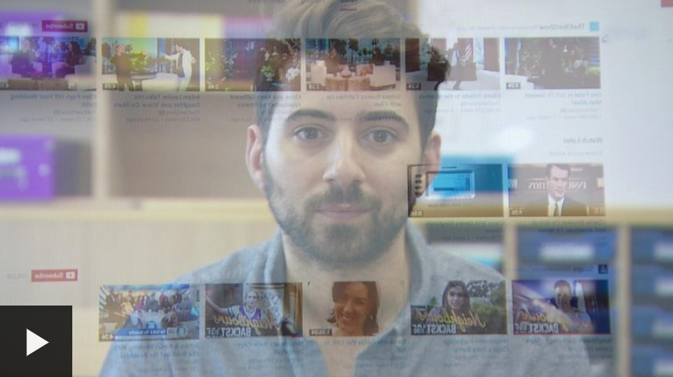
How do you spot fake news?

Slide 15





How do you spot fake news?
Has the story been reported anywhere else?
Is it on the radio, TV or in the newspapers?
Have you heard of the organisation that published the story?
Does the website where you found the story look genuine?
Does the website address at the very top of the page look real?
Does the photo or video look normal?

Slide 16


You can spot fake news...
Has the story been reported anywhere else?
Is it on the radio, TV or in the newspapers?

Slide 17
Digital Footprint
88 per cent of sexting images end up on public websites. (Internet Watch Foundation)
Notes:
Quick fact

Slide 18



Digital footprint
Instagram's new terms of service, which go into effect on January 16th, clearly state that your photographs and associated information (like location data) can be promoted by companies without anyone notifying you about the transaction. It's not even hidden in legalese — it's right there in black and white:
Used the word ‘Faggot’ on tweets
Homophobic language between 2011 and 2014
Insulting fat people – ‘fat chav’

Slide 19


Sexting -
Sexting is when someone shares sexual, naked or semi-naked images or videos of themselves or others, or sends sexually explicit messages.
88 per cent of sexting images end up on public websites. (Internet Watch Foundation)
that if they receive any indecent images they are just as liable as the person sending the images, even if they didn’t ask for them or they are sent by a best friend or boy/girlfriend
The Law
If you are under the age of 18, the law sees you as a child. Therefore, if you have any indecent images or videos of somebody who is under 18, including yourself, you would technically be in possession of an indecent image of a child. This is an offence under the Protection of Children Act 1978 and the Criminal Justice Act 1988.
Although the Police may not prosecute a teenager for sending or possessing indecent images, this could go down on their record.
This could then affect any future employment such as teaching etc.
No control of images and how they are shared
Blackmail

Slide 20

The Law: Sending Images
FACTS
Sending photos or videos If you are under 18 and you send, upload or forward indecent images or videos to friends or boyfriends/girlfriends, this would also be breaking the law, even if they are photos of yourself (“selfies”).
Notes:
Clarify these important facts with regard to the law. Ask what surprises them, did they know this information?

Slide 21
The Law - Receiving Images
FACTS
If you are in possession of images of a sexual nature of someone under 18 (even if it is your friend or boy/girl friend), you are committing an offence.
Offenders can be placed on the sex offenders register and can be given a prison sentence.
This is also the case if you have kept or printed out an image sent to you by a friend
Notes:
Make sure they understand that simply by being sent an image, they are just as liable in the eyes of the law. Discuss this – it doesn’t seem fair but it is the law. Discus the implications of being sent something like this. What should they do?
The official advice would be if it is not malicious, but from friend etc, then just delete. If it is malicious or from someone older then report to parents/teachers/police. In this case they should keep the image on whatever device it is on in case it is needed for evidence but not to print out or show anyone else or they will also then become liable under the law for passing on or possessing indecent images of children.

Slide 22
Consequences
FACTS
Although the Police may not prosecute a teenager for sending or possessing indecent images, this could go down on their record.
This could then affect any future employment such as teaching etc.
Also could affect travel – you can’t
go to America with a criminal record!
Notes:
Clarify – you could receive a police caution, or record, you could be placed on the sex offenders register or go to prison. However, the most likely scenario for young people is a warning unless repeat offending. However, because sending/possessing or receiving indecent images of children is against the law – they don’t know what the consequences might be. Better to be safe than risk affecting their whole future.

Slide 23
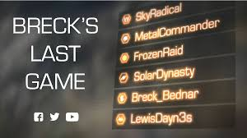
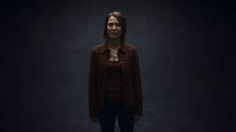
Watch ‘Breck’s Last Game below
https://www.youtube.com/watch?v=U_fExISISv4
Breck’s case is an extreme example but there are many dangers online and it is important to be aware of your and others behaviour.
What happened to Breck is a true story, why do we need to be sensitive when discussing this topic?

Slide 24
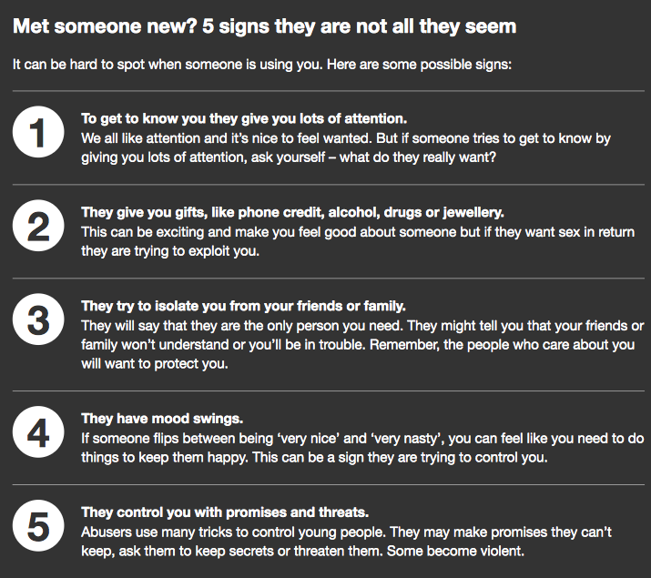
Grooming

Slide 25

What to do
ADVICE
Don't reply to messages that are meant to harass or upset you. This is likely to encourage the bully
Keep the message: you don't have to read it, but keep it as proof. It is vital to have a record of the incident when you look for help or want to report it.
Do not email or print out the image
Report problems to people who can do something about it, parents, school, police.
Block the sender. You don’t have to put up with someone harassing you - block unwanted senders!
Tell someone you trust. Talking to your parents, friends, a teacher, youth leader is usually the first step in dealing with any issue.
Talk to Childline
Respect yourself and respect others - being online is very public and very real, although it doesn’t always feel that way.
Notes:
Discuss in pairs first then share then clarify with the bullet points.
Add to their advice sheets anything else they think is important.

Slide 26
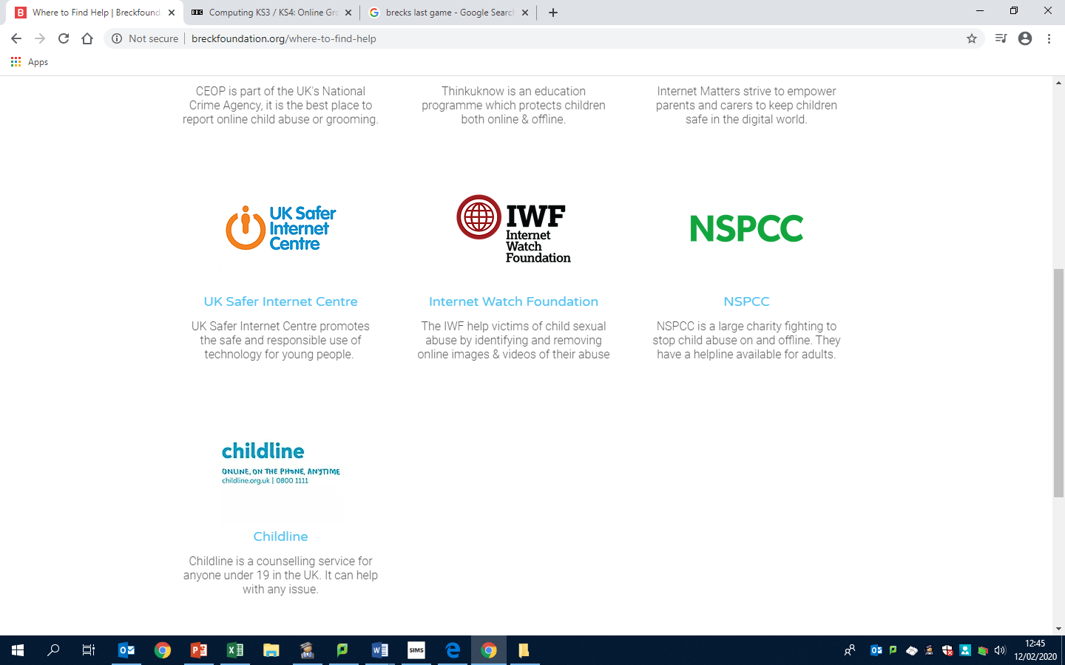


There are many websites designed to help people who are worried about online grooming.
If it is an emergency you should always call 999
CEOP is part of the UK's National Crime Agency, it is the best place to report online child abuse or grooming.
Thinkuknow is an education programme which protects children both online & offline.
Childline is a counselling service for anyone under 19 in the UK. It can help with any issue.

Slide 27


Check List…
Look at where you go to get free music legally at www.pro-music.org
Check your friends list – do you know everyone?
Delete any ‘random’ friend adds you may have
If you wouldn’t say it to someone's face, don’t say it online
Search yourself online
Make sure you set your privacy settings to friends only
Think before you post!
Visit: wwwsaferinternet.org.uk or www.childnet.com

Slide 28
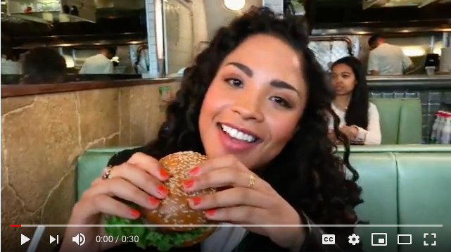
This is a reminder of why we need to keep our information private

