Slide 1


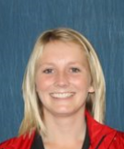
Year 11 into post 16
Miss Sarginson
Hi Year 11! I hope you are all well in these very bizarre times, stay in and stay safe please…

Slide 2
Just in case - No plans for September?
Colleges and 6th forms are still accepting applications
There are people still working behind the scenes to get places organised for September, 2020
Make a phone call, drop an email, apply online!
A lot of establishments are doing telephone interviews
For the Pool Hayes Academy prospectus and 6th form online application, use the link below:
https://poolhayes.attrust.org.uk/sixth-form-prospectus/

Slide 3
Why Pool Hayes academy 6th form?
Student leadership team
Smart business wear
More formal than college
Closer to home, more time/less cost travelling
I already know the teaching staff
From the opinion of current Pool Hayes Year 12 students…
Extra support with applications for university
Small numbers of students, more time focussed on me
Pool Hayes have high expectations of me and will push me
I already know the structure of the school
OFSTED report 2018, ‘Teaching in the sixth form is good because students are taught by the school’s strongest teachers. These teachers are specialists in their subjects.’

Slide 4
qualifications
A Levels
BTEC Level 3
GCSE re-sits for English and Mathematics (if necessary)

Slide 5
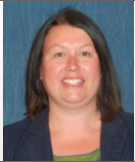
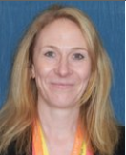
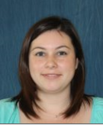
Meet The team
Mrs Macey
Mrs Mason-Wait
Miss Rudge

Slide 6
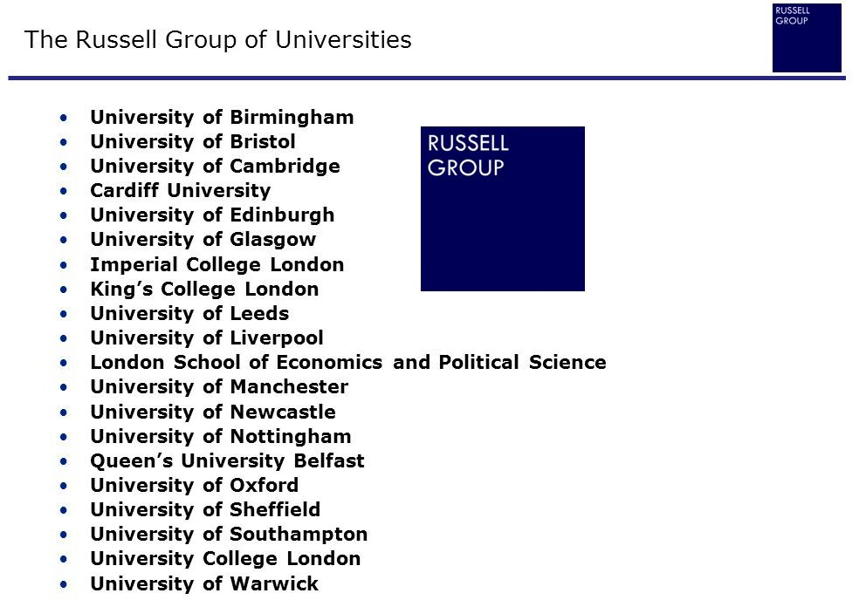

Miss Sarginson’s Tips for 6th form
Working school weeks 38/52 in each year
5/7 days in each week
An average of 4/24 hours contact time in each day (approx. 8% of your time)
How you use the time left over (approx. 92%) , makes a huge difference to your outcomes…

Slide 7
Study skills that will benefit you
Start
Start to get prepared for 6th form now, with extra time on your hands, you can get ahead of the game for next year…
Organise
Get organised – use a planner, set goals, record deadlines, details of exam board..
Schedule
Work to a schedule – Little and often, don’t leave things until the last minute, rushed work is often incomplete and inferior in quality
Environment
Work in a studious environment – away from distractions of the TV, smart phones and other devices
Help!
Ask for help when needed – Don’t pretend you understand when you do not, don’t suffer in silence!
Resources
Use all available resources to you – teachers; textbooks; libraries; fellow students; the internet…
Set goals
Motivate yourself with goal setting – on a micro scale...watching your favourite Tv programme after an hours work of revision, on a larger scale, a university offer
Dictionary
Get a dictionary – exam boards will now penalise for poor spelling and poor grammar
Read
Read, read, read – this should be a core activity, you are faced with three challenges, the volume of reading, the complexity of the material you will need to read, and retaining the information you have read.

Slide 8
By the time you have finished 6th form
Key word: UCAS – The Universities and Colleges Admissions Services
Had the opportunity to undertake a minimum of one week’s work experience in a company of your choice. You will be responsible for arranging the placement, with support from family, friends and the school.
Attended Year 12 sessions on higher education, gap years, student finance, Apprenticeships etc.
Had the opportunity to attend careers talks during the school year from visiting speakers on a variety of topics.
Been guided through the UCAS application process and made an application through UCAS, if you intend to go to university.
Had the opportunity to attend the UCAS Education Convention and individual university and college open days.
Had the opportunity to attend Apprenticeship and Skills events.
Had the opportunity to seek optional access to impartial information, advice and guidance from the school’s careers advisor for support with university and college applications (both in the UK or abroad) and alternative options such as apprenticeships, seeking employment, voluntary work, taking a gap year etc.

