Slide 1

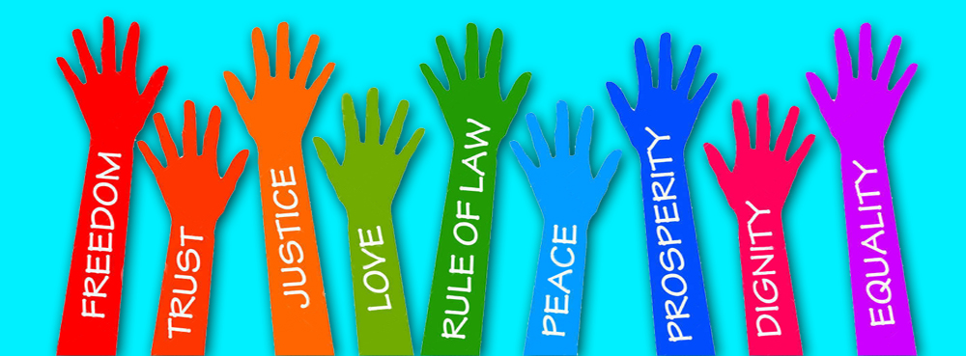
Home Learning 2020
British Values-
Human Rights
Complete the tasks on this power point in the boxes given and email back completed work to Mrs Rowlinson
j.rowlinson@poolhayes.attrust.org.uk

Slide 2
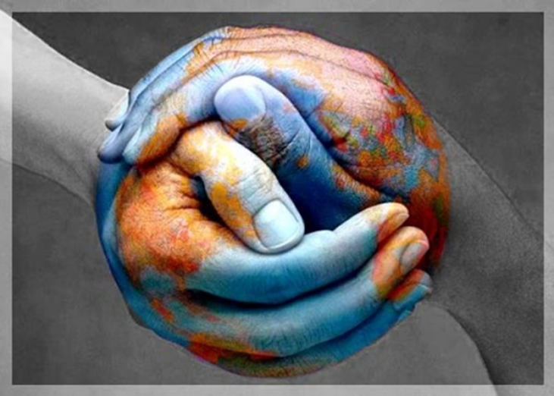
Task 1- To identify violations of Human Rights
What are Human Rights?
This activity uses shocking images from the Holocaust
We will use these images to develop our own ideas about the principles behind human rights
Look at the following images and write down what you think has been taken away from these people

Slide 3
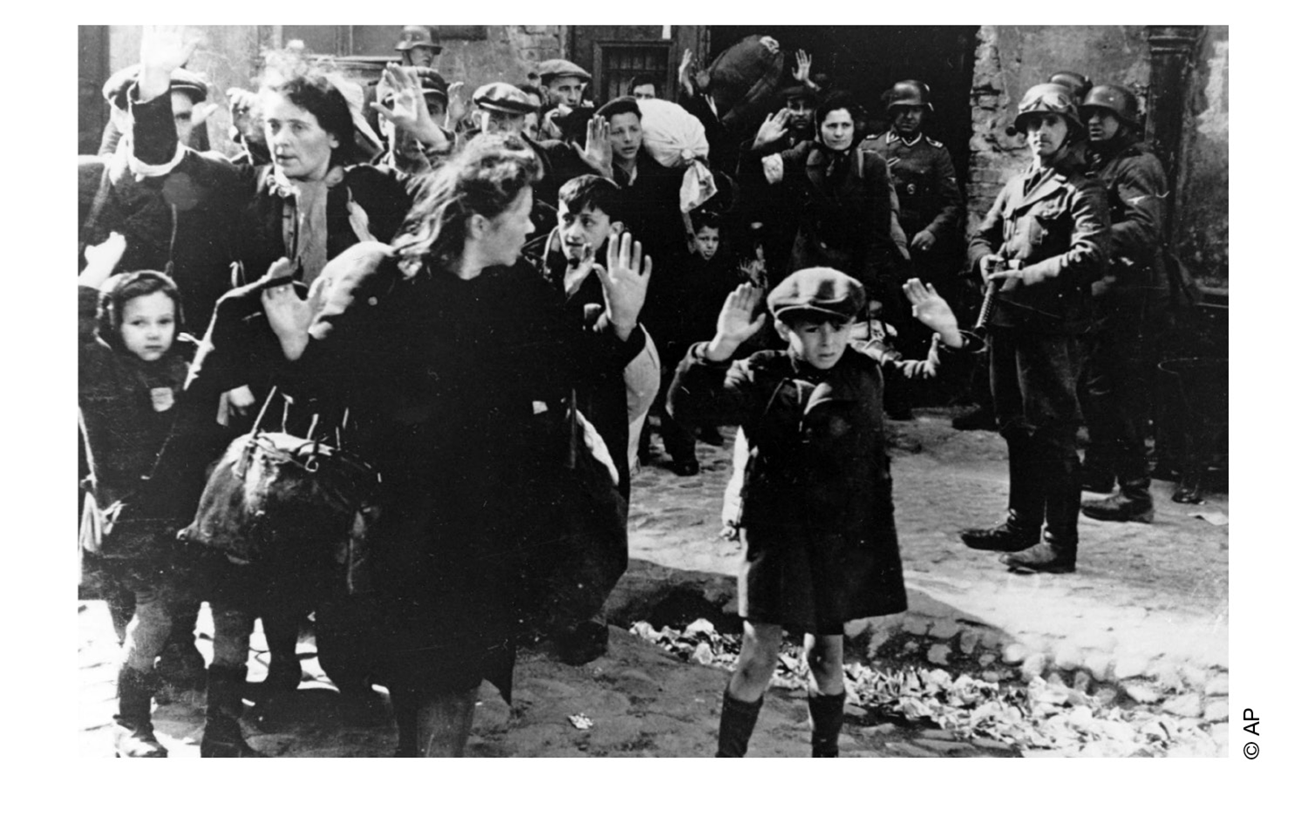
Task 1- To identify violations of Human Rights
What is being taken away from these people?

Slide 4
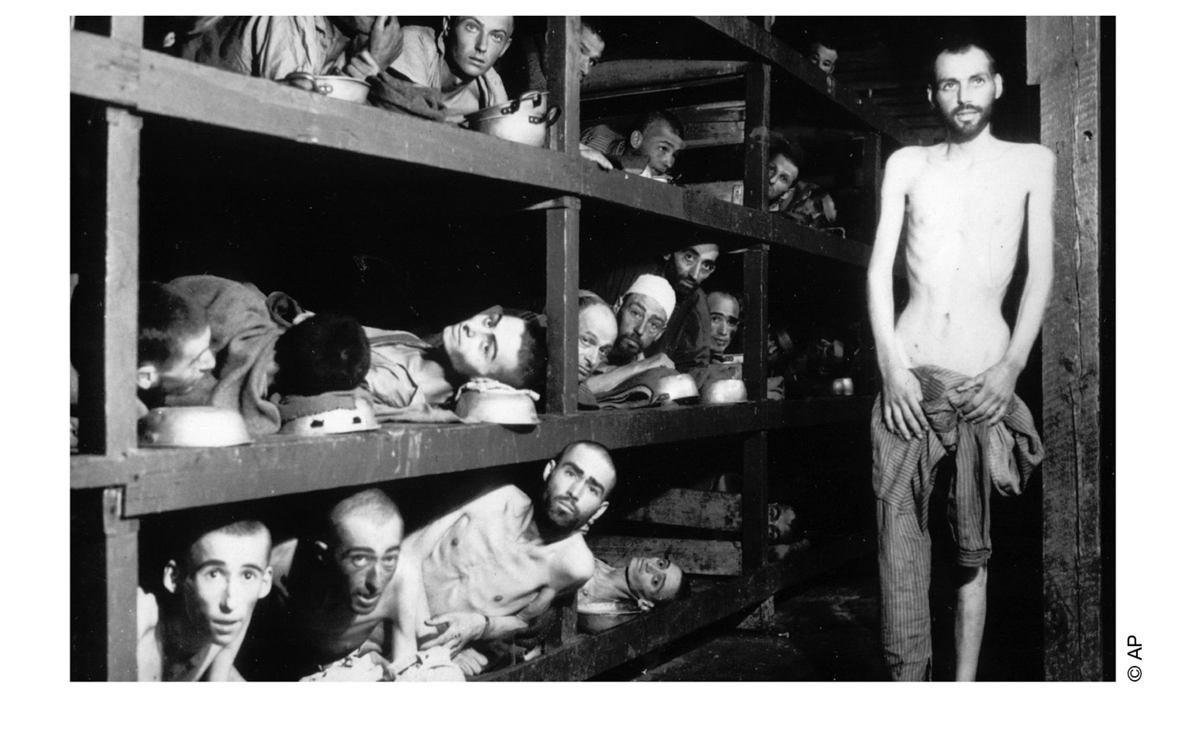
Task 1- To identify violations of Human Rights
What is being taken away from these people?

Slide 5
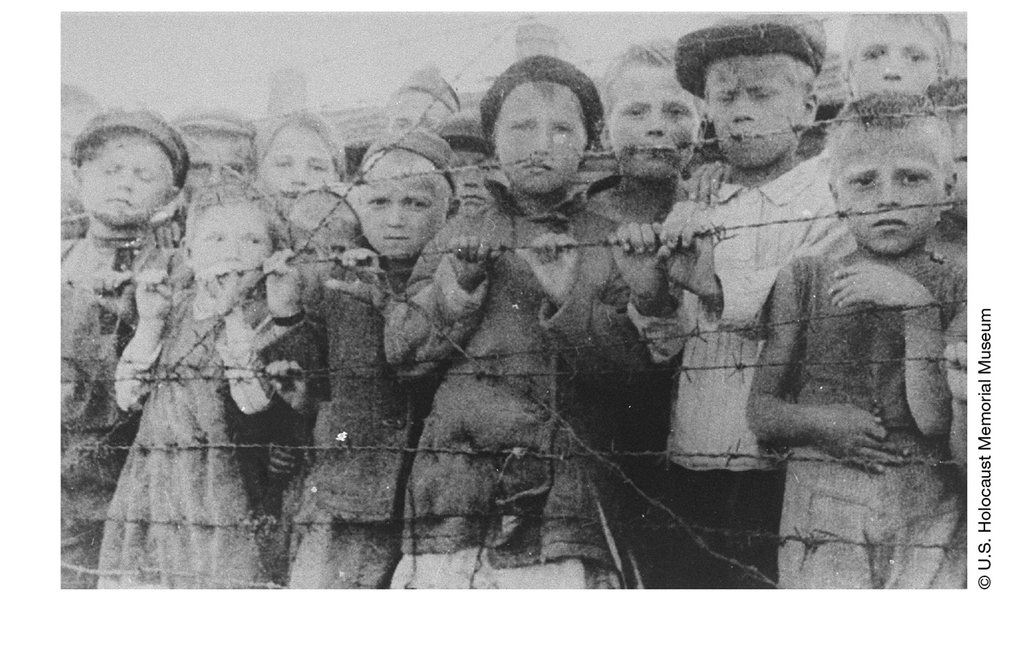
Task 1- To identify violations of Human Rights
What is being taken away from these people?

Slide 6
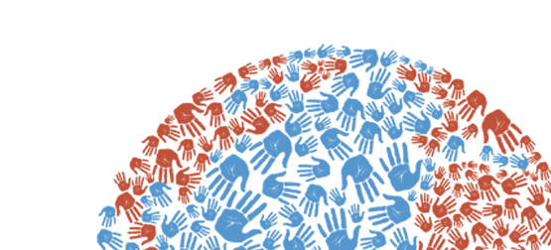
Task 1- To identify violations of Human Rights
Complete the mindmap below
Add as many ideas as you can
‘What is a “human right”?’
Writes the three words that you think sum up your ideas
1.
2.
3.

Slide 7
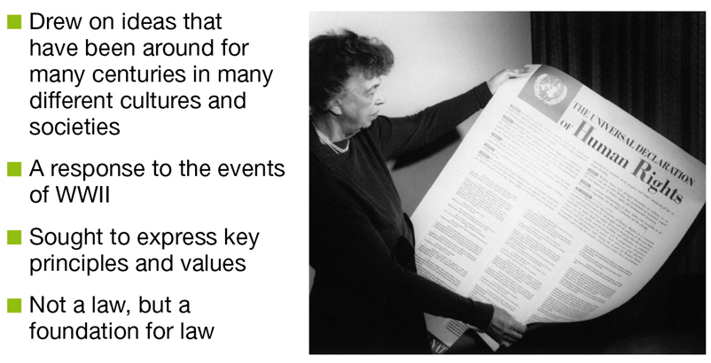
Task 2- To highlight the fundamental beliefs of the Declaration of Human Rights
The Universal Declaration of Human Rights
After the Holocaust the world’s leaders came together to work out how to stop future atrocities, and did exactly what you did in the last activity. The eventual document drawn up in 1948 is called the Universal Declaration of Human Rights (UDHR). It sets out all the rights they thought every human should have.

Slide 8
Task 2- To highlight the fundamental beliefs of the Declaration of Human Rights
The Universal Declaration of Human Rights
The following words are written on the Declaration before it lays out the 30 Rights that all humans deserve
If everyone can recognise the essential dignity and worth of all human beings and if everyone can recognise that all human beings have some basic, equal rights, then this will lead to freedom, justice and peace in the world.
Disrespect for human rights has led to horrific acts that have outraged people across the world. We all want a world where people can enjoy freedom of speech and belief and freedom from fear and want. If these rights are made law, then people will be protected from tyranny and oppression.
It is important that people understand these rights and freedoms as this will lead to a better, fairer standard of life for everyone. We have dedicated ourselves to promote universal respect for these rights.
We see the Universal Declaration of Human Rights as a common goal for all people and all nations. We hope that every individual and every organ of society will try by teaching and education to promote respect for these rights and freedoms. We hope that both individuals and governments will try their best to make sure that these rights are fully respected both in their own country and across the world.

Slide 9
Task 2- To highlight the fundamental beliefs of the Declaration of Human Rights
The Universal Declaration of Human Rights
Highlight three words in red (e.g dignity) that you think are important in the fundamental beliefs of the declaration of Human Rights
If everyone can recognise the essential dignity and worth of all human beings and if everyone can recognise that all human beings have some basic, equal rights, then this will lead to freedom, justice and peace in the world.
Disrespect for human rights has led to horrific acts that have outraged people across the world. We all want a world where people can enjoy freedom of speech and belief and freedom from fear and want. If these rights are made law, then people will be protected from tyranny and oppression.
It is important that people understand these rights and freedoms as this will lead to a better, fairer standard of life for everyone. We have dedicated ourselves to promote universal respect for these rights.
We see the Universal Declaration of Human Rights as a common goal for all people and all nations. We hope that every individual and every organ of society will try by teaching and education to promote respect for these rights and freedoms. We hope that both individuals and governments will try their best to make sure that these rights are fully respected both in their own country and across the world.

Slide 10
Task 2- To highlight the fundamental beliefs of the Declaration of Human Rights
Feedback on these words and compare them with the list you made in the first activity. How similar were your ideas to the leaders of the world in 1948?

Slide 11

Task 3- To create an advert promoting Human Rights
Watch the advert for Amnesty International and make a note of the human rights that are shown being violated during the film.
https://vimeo.com/17326908
Which Human Rights are being violated?
Do you think Amnesty has chosen a good title for their film? Why?

Slide 12

Task 3- To create an advert promoting Human Rights
Choose one of the Human Rights below and delete the others
We all have the right to life, and to live in freedom and safety.
We all have the right to education, and to finish primary school, which should be free.
Nobody has any right to make us a slave. We cannot make anyone else our slave.
You have been asked by the United Nations to create a two-minute advertisement for young people illustrating the importance of the right you have picked
Come up with an idea for an advert. You can choose to write the idea down, draw a storyboard or a script for your advert

Slide 13
Task 3- To create an advert promoting Human Rights
Advert idea-

