Slide 1
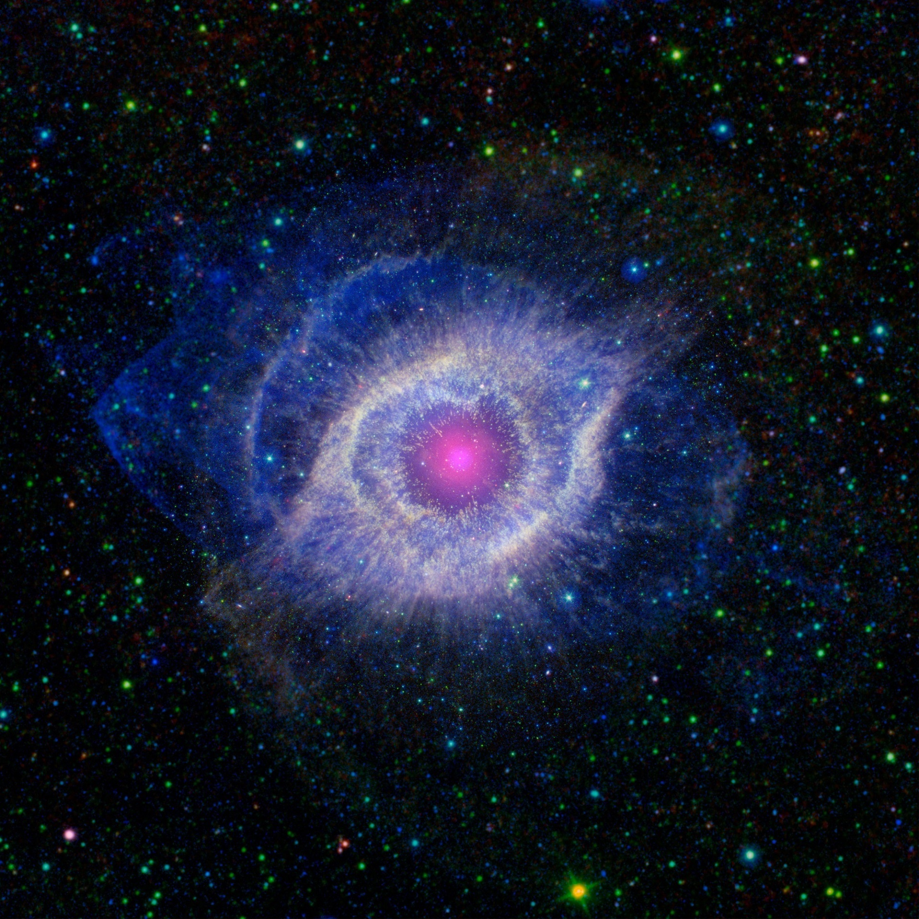
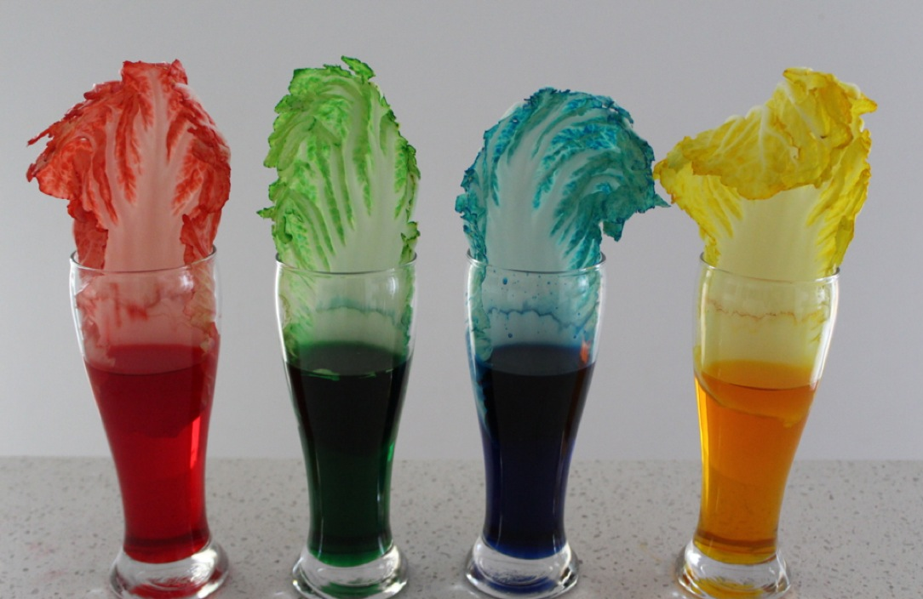
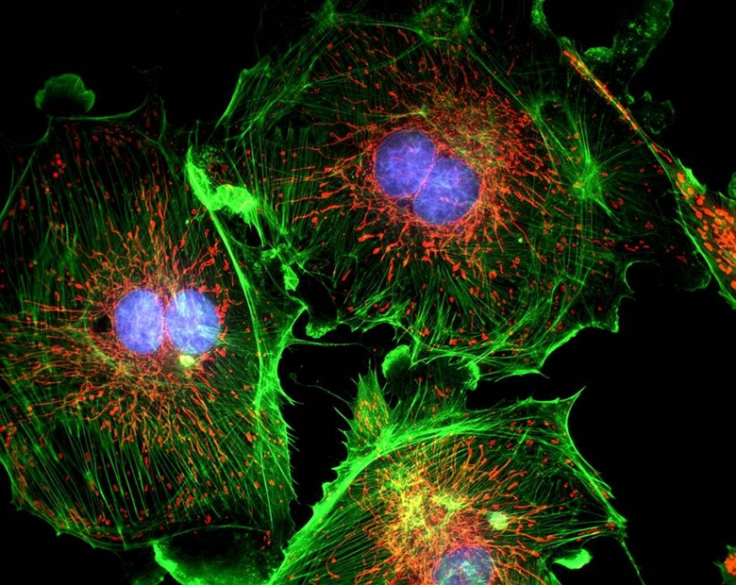
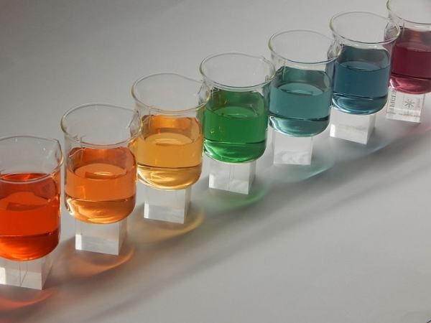
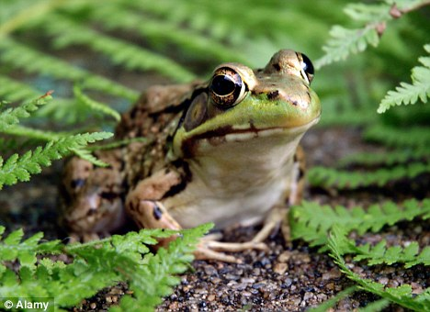
Year 7 Challenge
Hi everyone, your challenge is to send me a drawing or poster on what you like and know about science.
You could talk about :
An experiment you did at your primary school
or
A cool thing you did at home that links to science
or
Which aspects of science you like the best and why.

