Slide 1
UCAS APPLICATIONS
How to register – UCAS 2021

Slide 2

www.ucas.com
STUDENTS

Slide 3
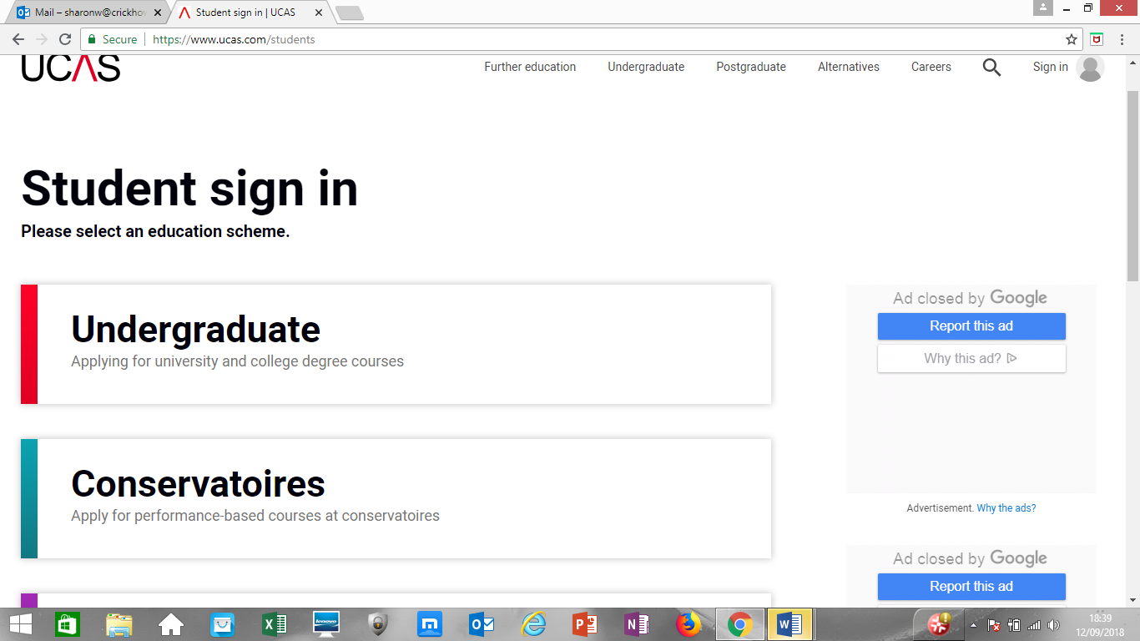
Click Undergraduate

Slide 4


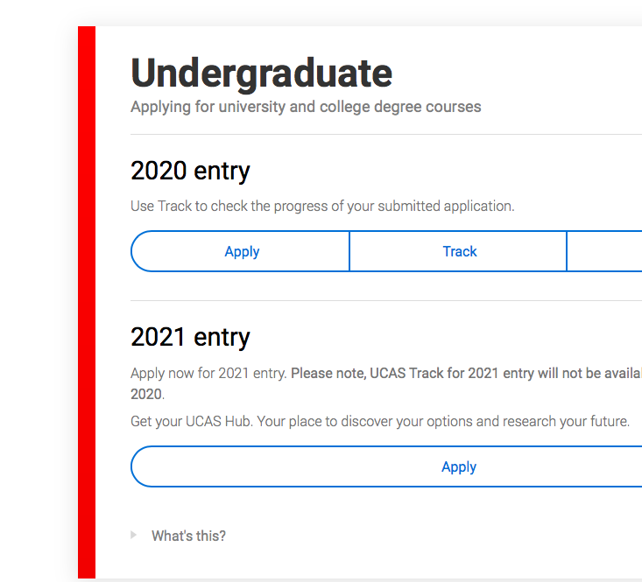



You need to register first

Slide 5
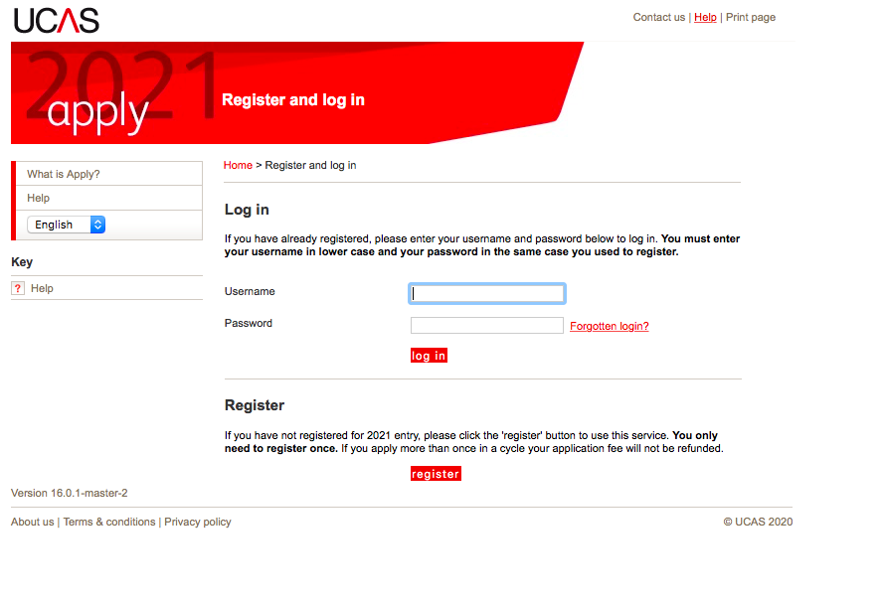
Click REGISTER
Don’t try to log in – your UCAS log in will be for the main site not APPLY.

Slide 6
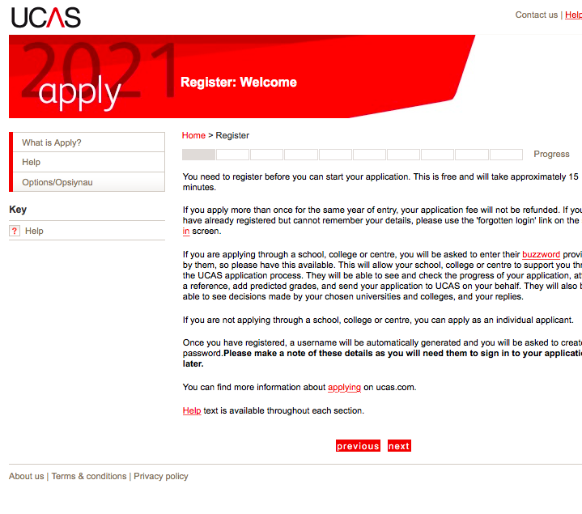
next

Slide 7
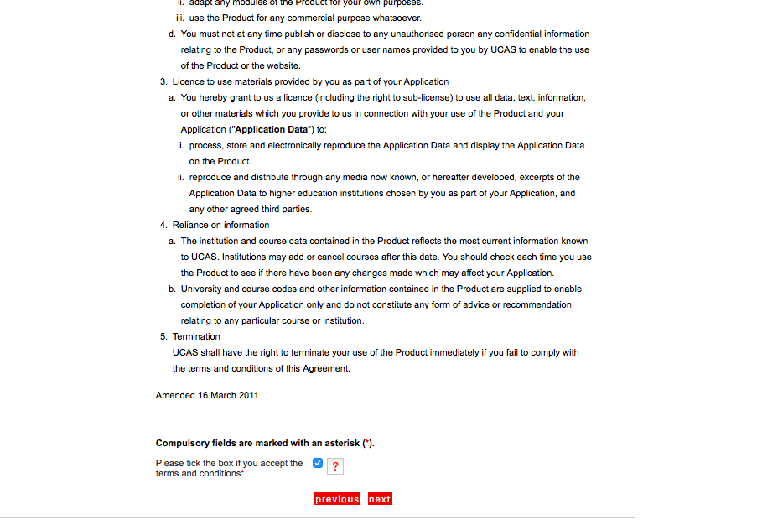
Accept terms & conditions and press ‘next’

Slide 8
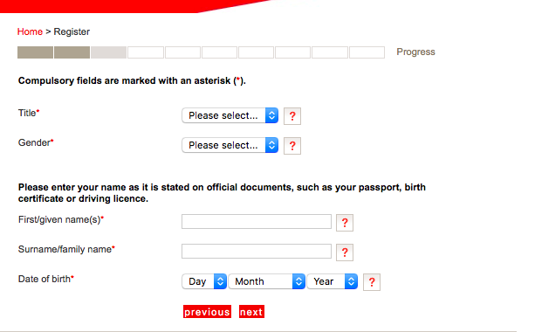
Ensure that your first name matches that on your exam entries/ exam certificates. Ie – Katherine not Kate

Slide 9
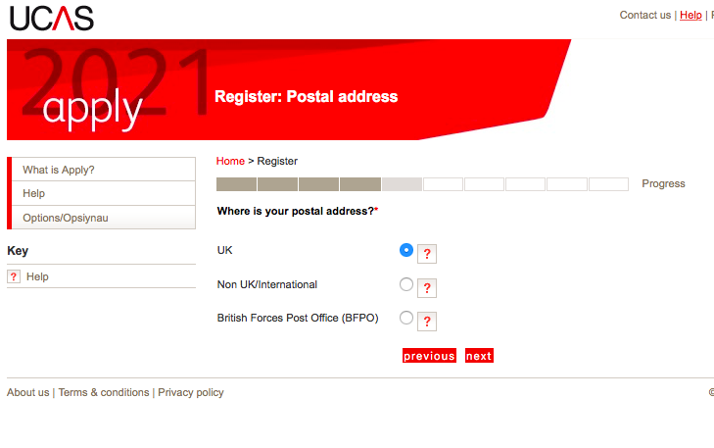

Slide 10
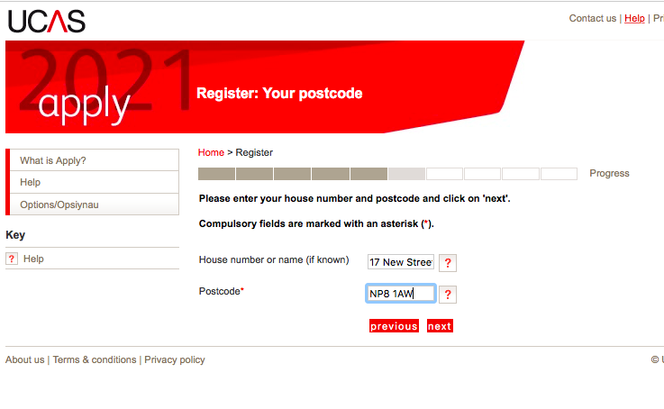
Use correct capitals for house name

Slide 11
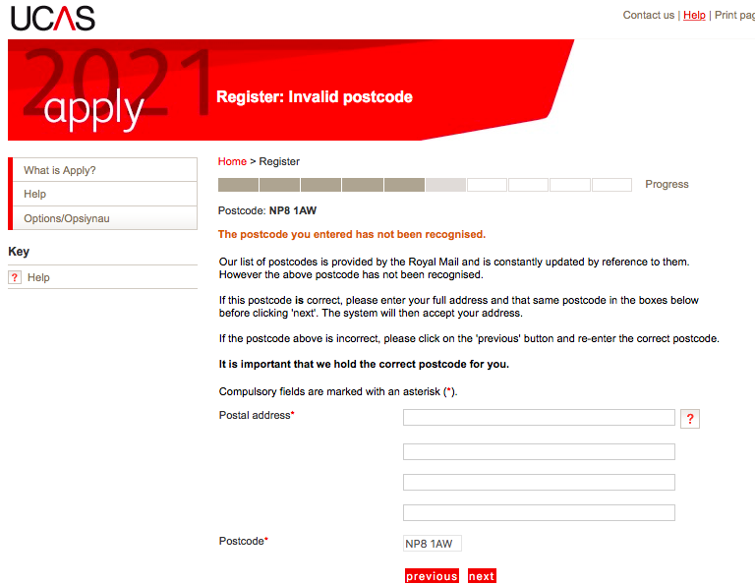
This usually happens. Just make sure you use capitals correctly when you type address in.

Slide 12
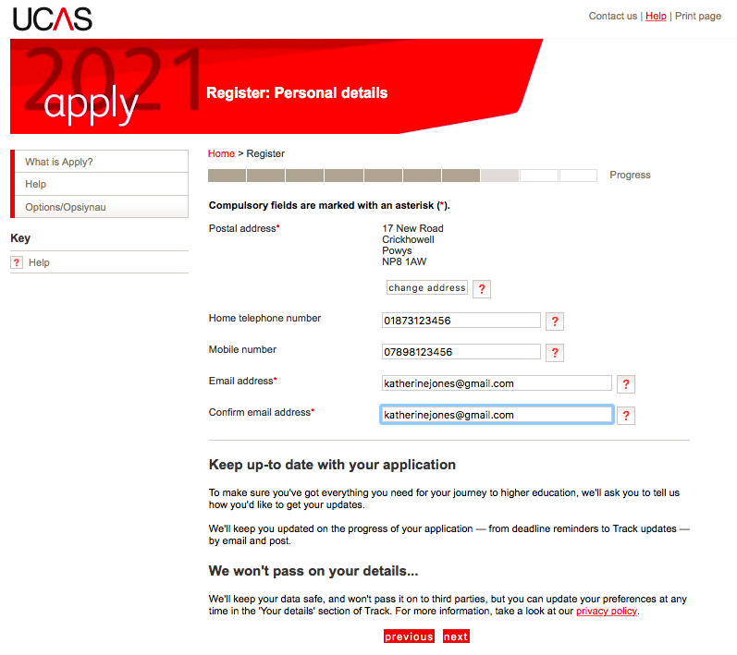
Sensible email address that you check very regularly. Can be school or home.

Slide 13
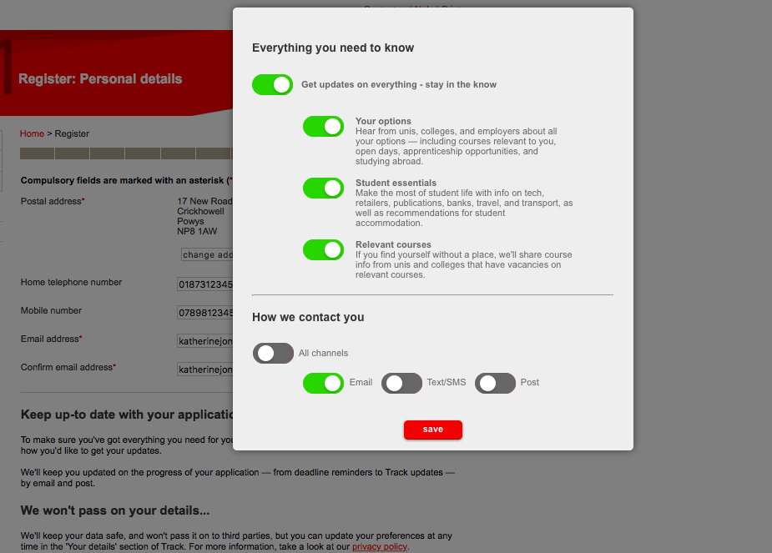
You can choose how they contact you.

Slide 14
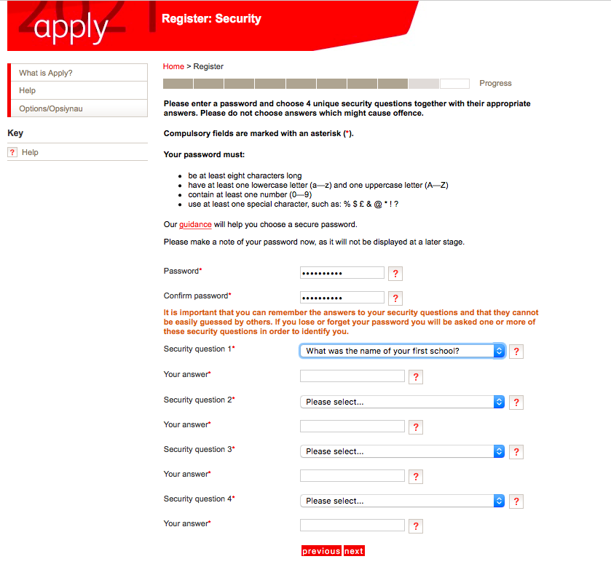
Write down your PASSWORD and the answers to the 4 security questions – including whether they are upper or lower case!

Slide 15

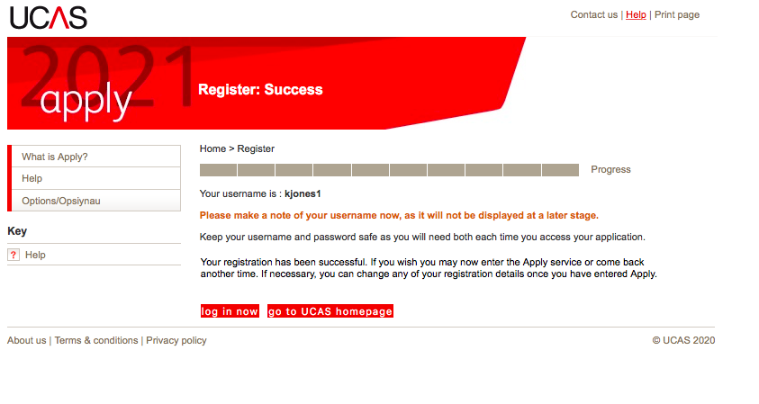
Write down your username – it is only in little writing and won’t appear again! Then go to LOG IN NOW

Slide 16
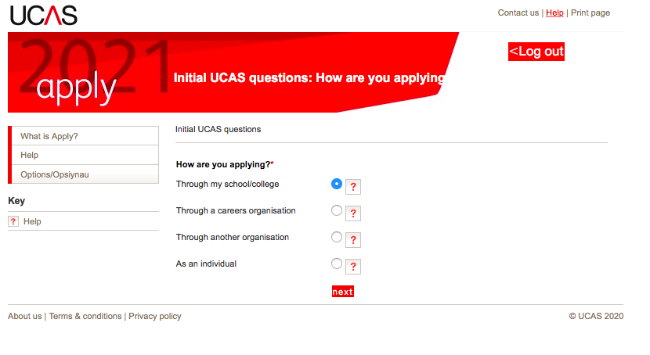
You are applying through school/ college

Slide 17
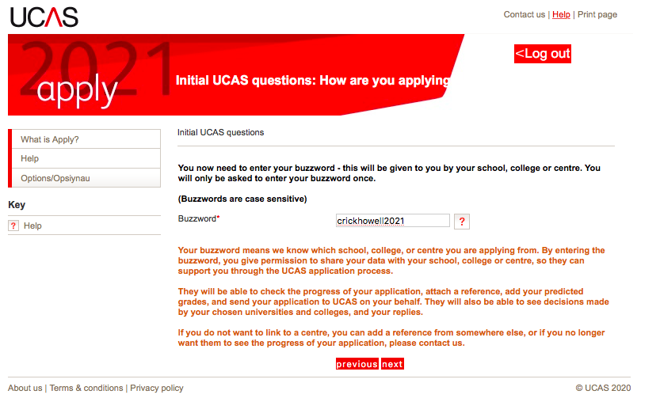
Buzzword is xxxxxx

Slide 18
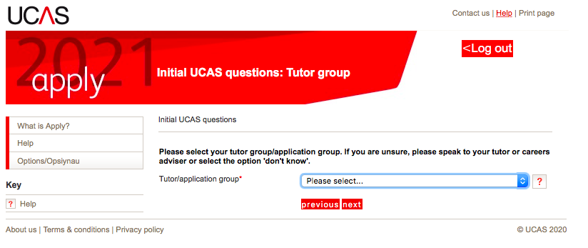
Select INTERNAL APPLICANTS 2021 as group

Slide 19
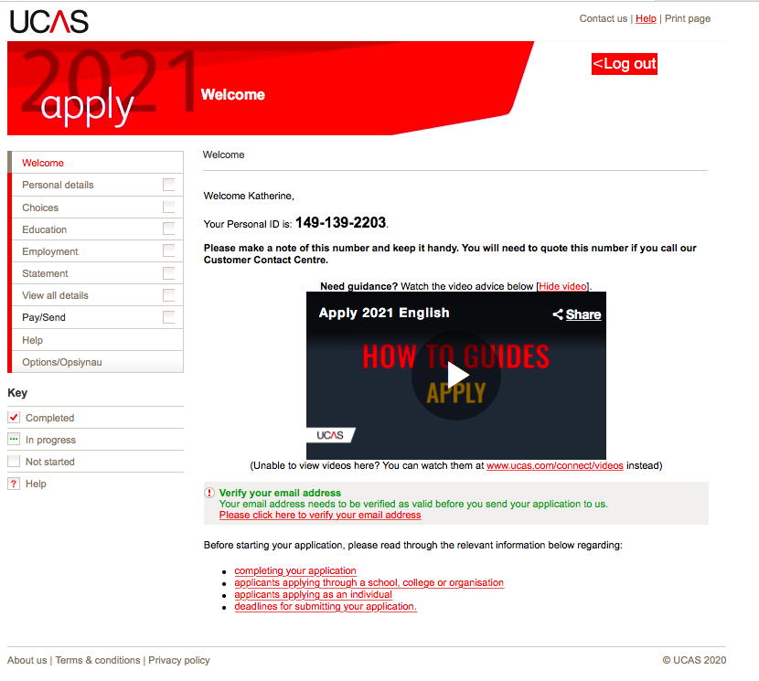
Make a note of your personal ID – again it doesn’t appear again. You can verify your email now or later but it must be done before you can ‘complete’ your application. Watch the video!

Slide 20
Then click on PERSONAL DETAILS

Slide 21
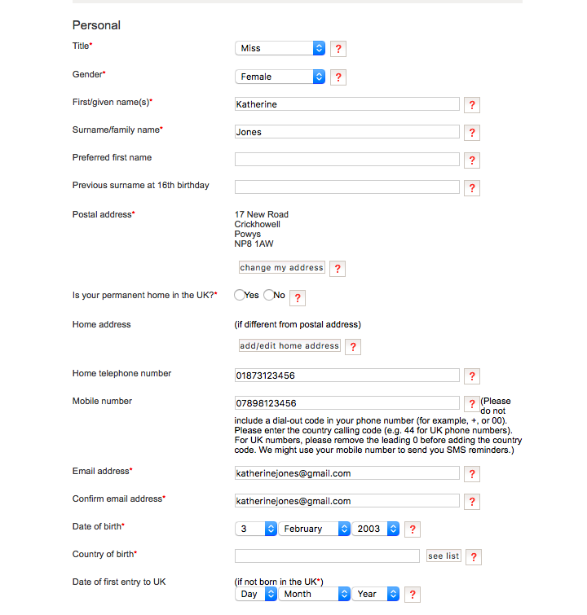
Personal Details
NB your name should be the same as your exam entries
Preferred name can be your shortened name eg Ben not Benjamin
Only fill in surname before 16th birthday if you have changed your name since you turned 16 – otherwise don’t put anything here
Tick yes for permanent home
Country of Birth – United Kingdom
Nationality – UK National (in the majority of cases) – what passport do you hold?
Do not put dual nationality – unless you hold 2 passports.

Slide 22
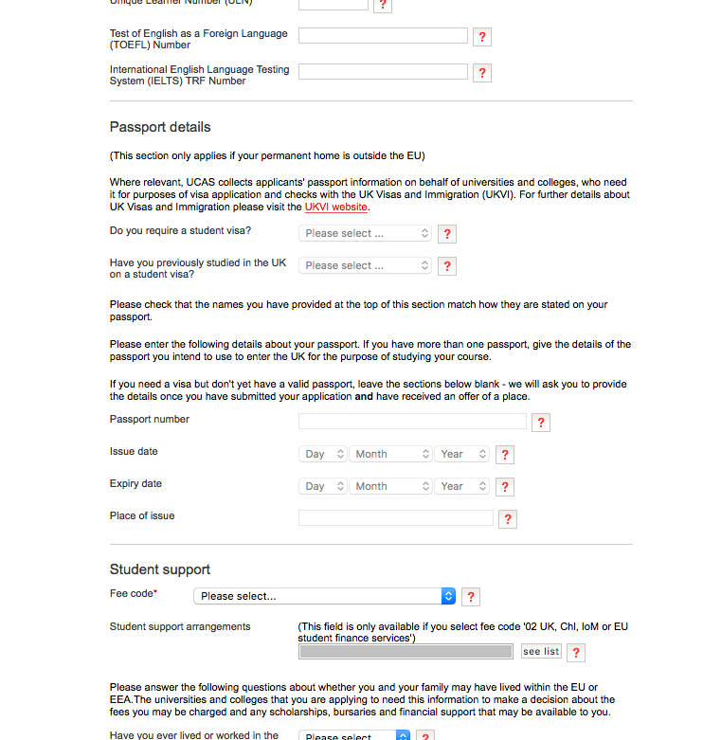
Personal Details
Area of Permanent Residence – will be xxx for most – the county where you LIVE. … use the LIST
Residential Category – most will be UK Citizen Wales – use the LIST
Don’t worry about all the reference numbers. If you can find your ULN on exam entries or results, that’s great.
Don’t need to complete passport details
Fee Code – most will be 02 – check again before application goes off re sponsorship etc
Student Support Arrangements – select xxx depending on where you live – use list
Parent who is not a UK National … ?
Nominated Access – this is up to you! However, I recommend you put xxx so we can help with any issues.
Criminal Convictions – only tick if you HAVE a conviction!
Disability/ Special Needs – only include something here is it is registered and official – ie a statement. But DO include if you have one as lots of funding available.

Slide 23

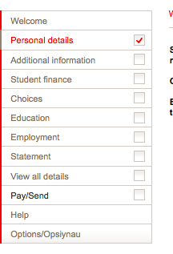
Personal Details
You can save as you go along – you don’t need to complete the whole section at once.
When all answers are complete, you can tick the SECTION COMPLETE box and that will change to a red tick in the side margin menu.

Slide 24
Now click on EDUCATION

Slide 25
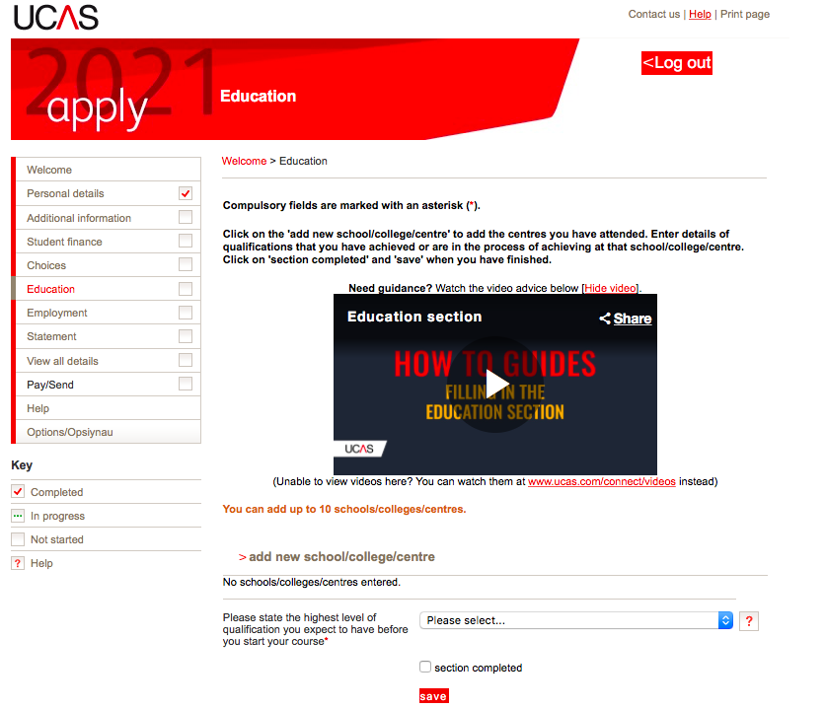
Add new school/ College

Slide 26
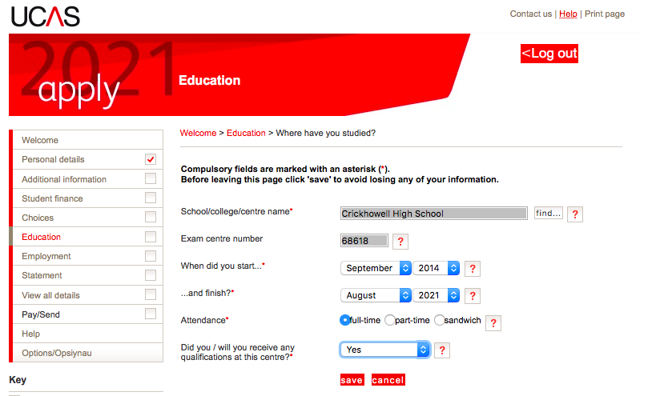
Add School
Add new school >>>>use find >>>> xxx >>> check exam number (xxxx)
If you joined us AFTER Year 7, your start date will be different.

Slide 27
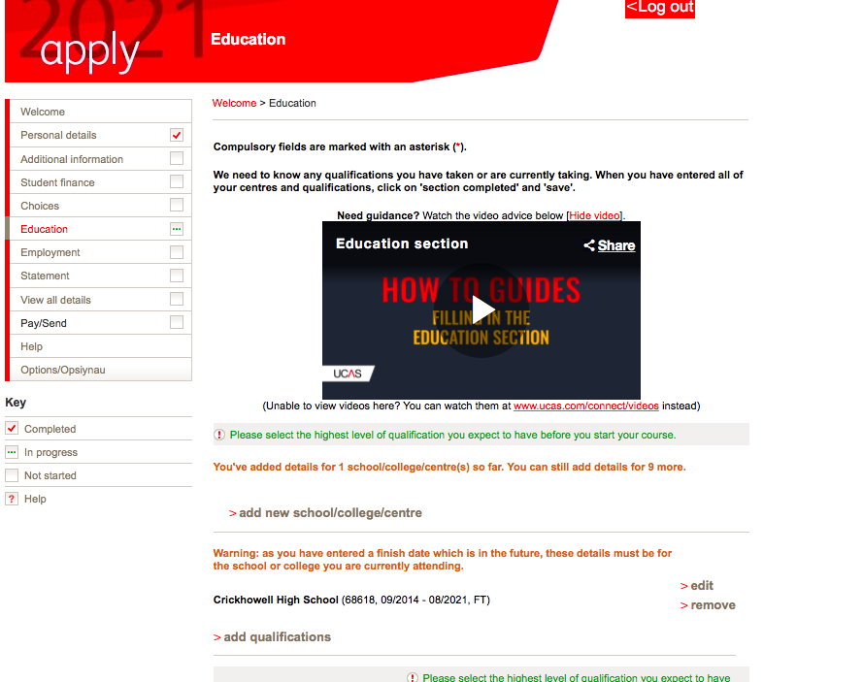
If you joined us for Sixth Form and sat GCSEs at another school …
Click ‘add new’ school college and enter details for your previous school.

Slide 28
Add qualifications

Slide 29
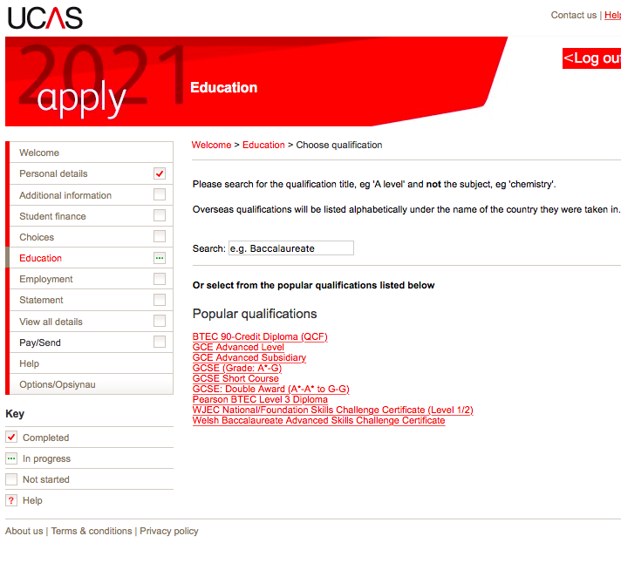
Add qualifications
I have done a shortlist of your qualifications to help you add the correct ones.
ONLY DO GCSEs at THIS POINT. WE WILL ADD AS AND A LEVELS IN SEPTEMBER.

Slide 30
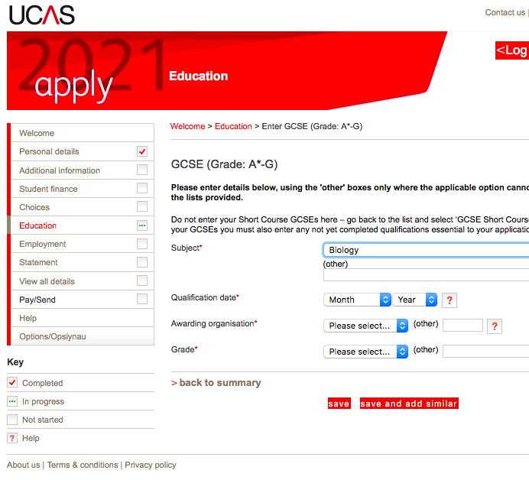
Education
Add qualifications >>>>
GCSE – add all GCSEs
– nb you sat ‘English Language’ and ‘English Literature’
>> date is August 2019
>>> Awarding Body = WJEC or other board
>>> use SAVE and ADD SIMILAR until all subjects are in
then start short course
Add Welsh Baccalaureate Skills Challenge Certificate– you can add the title of your Individual Investigation where it asks for module details.

Slide 31
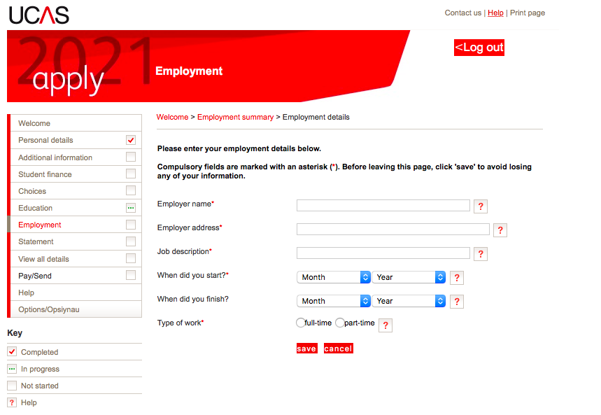
Employment.
Add employer – nb this is free text so check spelling and capital letters etc

Slide 32
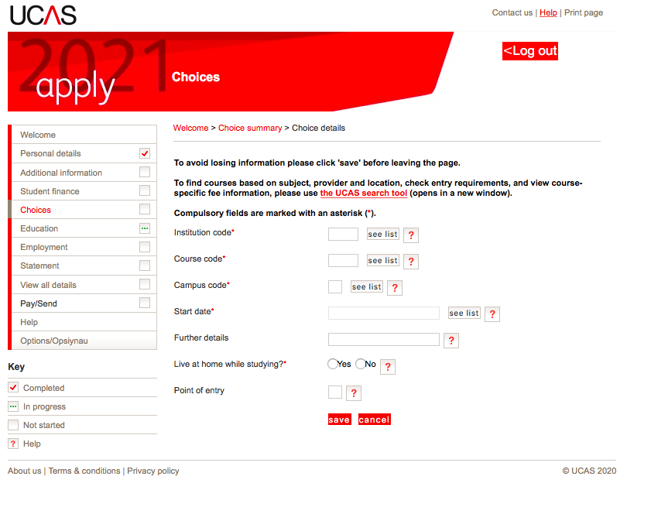
Choices
LEAVE UNTIL YOU ARE READY.
They are in no particular order. They will appear in alphabetical order on your form and won’t be visible to your universities.
You should have choices that are realistic with your predicted grades and make sure you have a back up for your insurance (lower entry requirement).
Do your research before completing this section!

Slide 33
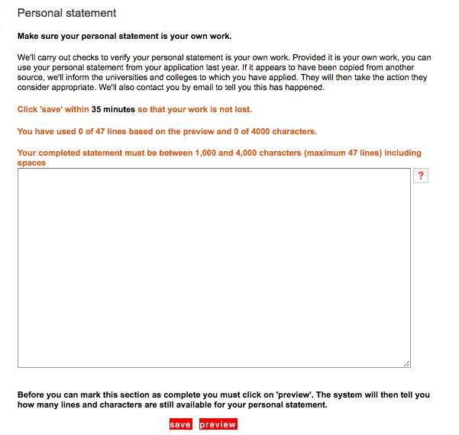
Personal Statement
UCAS have very sophisticated plagiarism software and this does happen and they do notify universities so be very careful about this!
Paste in in from Unifrog/Word when you are happy it is the final version.
Do not add more than 4,000 characters as it will cut off.
Check special characters such as pound signs and accents in languages as they do not always copy across.
CHECK THIS WITH FORM TUTOR/SIXTH FORM TEAM BEFORE YOU DO THIS.

Slide 34
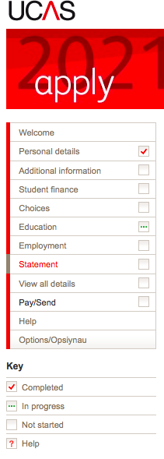
DEADLINES 15th October Oxbridge/Medicine/Dentistry 15th January – all other applications
When all the sections are ticked as COMPLETE, you will be able to PAY/SEND
This only goes as far as the Sixth Form Team to check. Not the universities.
We will send it back if there are amendments; keep checking emails as the message returns to the email you put on the UCAS form.

Slide 35
Next Steps
Work through the activities on UCAS HUB and begin your research
Read the CHS Higher Education GUIDE
Read and complete the CHS Personal Statement Guide
After ½ Term will will also assign your Unifrog Log ins so you can use this additional tool too.
Keep checking the Higher Education Channel in the Year 12 Team.
Ask for help – but not if the answer is in this powerpoint! ☺

