Slide 1
Email Mrs Rowlinson with any completed work-
j.rowlinson@poolhayes.attrust.org.uk
–
Learning at home?
This lesson works best in “Full Screen” mode – click the icon at the bottom right of your screen or use the “F5” key to start from the beginning. Use the space bar, mouse or arrow keys to click through!

Slide 2
Learning from home
Here are some ideas of how to get the most out of this lesson at home.
Text a friend to arrange a video call so you can do some of the activities together.
Explore the topic with a family member– how is their opinion different to yours?
You might need to open a word document if you want to complete some of these activities.
How to use this lesson…
Use these buttons to get the most out of your lesson.
Find this button in the bottom right of you screen to start your lesson.
Use the arrow keys to go forwards and backwards through your lesson.
To go back to your normal screen, press the esc key on your keyboard.
–
In the classroom?
You need the same things, but will need to swap the parent for a partner!
Learning independently?
Use the purple boxes to explore your ideas independently!
Don’t forget to vote…
You can find the link to do this on the final slide. Get your whole household involved!
Notes:
Images:
https://icons8.com/

Slide 3
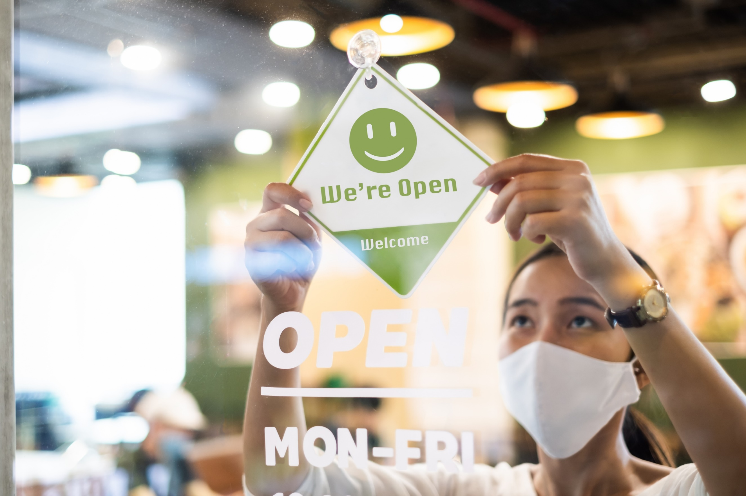
Are you ready for the new normal?
Notes:
Images
iStock

Slide 4
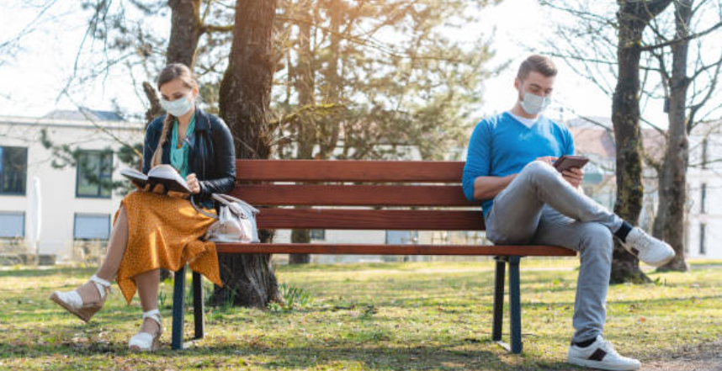
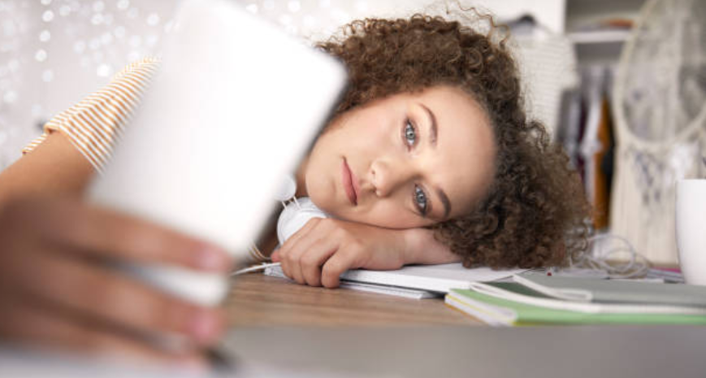
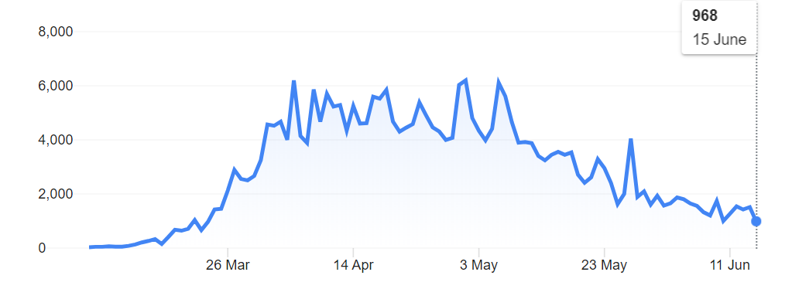
1
Why are we talking about this?
We’ve been in lockdown since March and with shops shut, holidays cancelled, social distancing in place and many students learning from home, the situation has felt far from normal.
Reports have shown that 2.3 million children have done ‘almost no schoolwork’ since the beginning of March. This, along with fears about jobs and the economy has pushed the government towards taking the first steps into what will be the new normal.
However, others are concerned that opening too soon and not doing it properly can risk a second spike, which could set us back even further. But what do you think? Are you ready for the new normal?
Notes:
Images
iStock
Wikipedia
References
https://news.sky.com/story/coronavirus-23-million-children-have-done-almost-no-schoolwork-in-lockdown-study-finds-12007649

Slide 5
2
What is the new normal?
There are lots of different measures the government have put in place to make sure everything can open safely and we don’t risk a second peak.
Group task (5-10 mins)
Have a look at some of the changes to lockdown that are happening in England and consider whether you think these changes are a good idea. If you think it is, put your thumb up. If you think it’s not, put your thumb down. Be ready to explain your reasons.
Is it a good idea?
Notes:
Images
Icon8
References

Slide 6
2
What is the new normal?
Shops have now opened, though many people will have to queue to get in. Most changing rooms are closed and shoppers are encouraged not to touch things unless they plan to buy them.
The Premier League has started again. Fans won’t be allowed to go to matches, but they will be on Tv.
Many hope all students will be back by September, but classrooms and hallways will need to have students 2m apart, and some are going to be on a half-in, half working at home system.
A new rule from the 14th June says that you’ll only be allowed on public transport if you’re wearing a face mask.
Anyone travelling to the UK has to stay in quarantine for 14 days afterwards.
In England, you can meet up to 6 people in your garden, though they are not allowed to go into the house. If they use the bathroom, everything would need to be cleaned thoroughly.
Restaurants, cafés, bowling alleys and pubs may start opening in July, but table and customers will have to stay 2 metres apart.
Is it a good idea?
Notes:
Images
Icon8
References:
https://news.sky.com/story/coronavirus-what-might-our-new-normal-look-like-when-the-uk-lockdown-is-eased-11979256
https://www.bbc.co.uk/news/explainers-52530518
https://www.gov.uk/government/publications/closure-of-educational-settings-information-for-parents-and-carers/reopening-schools-and-other-educational-settings-from-1-June
https://www.bbc.co.uk/news/education-53026221

Slide 7
2
What is the new normal?
Note: Skip if short on time.
Think (2-3 mins)
Right now some people might be feeling nervous or anxious about these changes. Why do you think this is?
They could be unsure if…
It’s confusing that…
They might feel worried that…
There are concerns around…
Some people are saying …
They may feel frustrated if…
Notes:
Images
Icon8
References

Slide 8
3
How do you feel about it?
Now that you know what the new normal is, how do you feel about the changes that affect your day-to-day life?
How do you feel about it? (5-8 mins)
On the next few slides decide how you feel about the different parts of the “new normal.” Use the feelings scale to show your answer!
Delighted!
Happy
Okay
Nervous
Worried
Challenge:
For each one, try to explain your reasons. If you’re not delighted, what could be done to help you to feel better?
In the classroom?
Hold up the number of fingers that shows your feelings. Remember to explain your reasons!
Notes:
Images
iStock

Slide 9
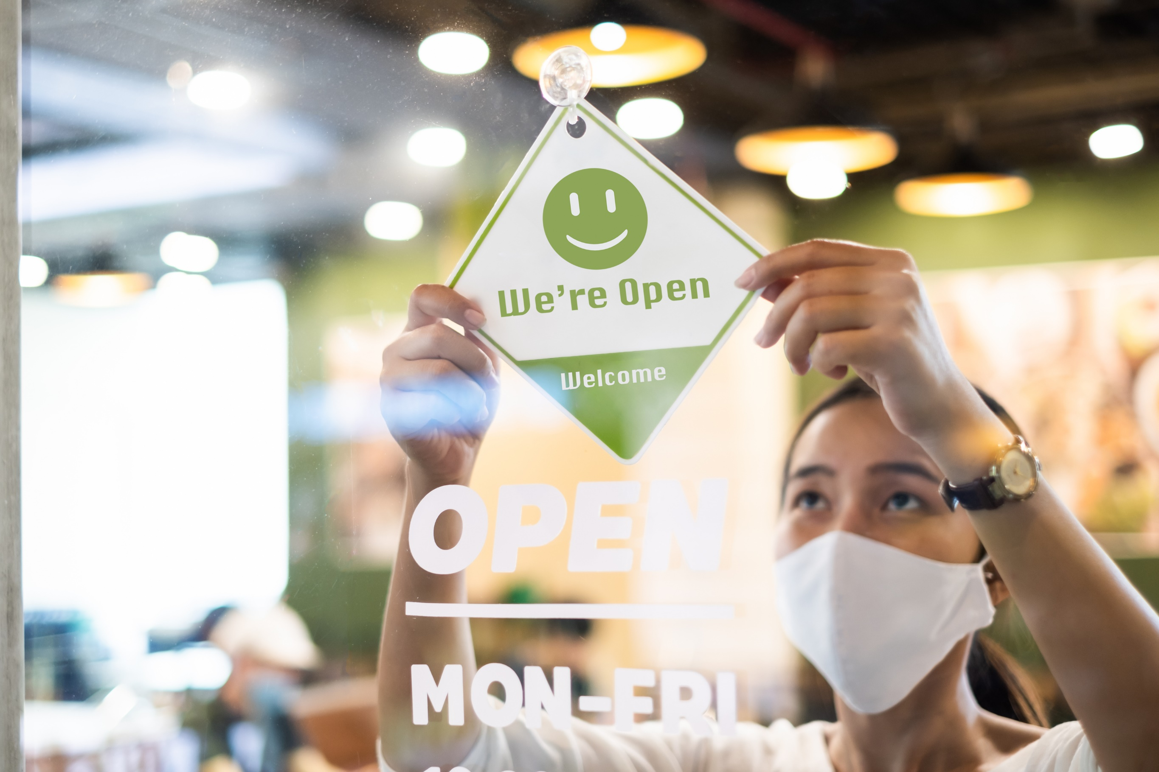
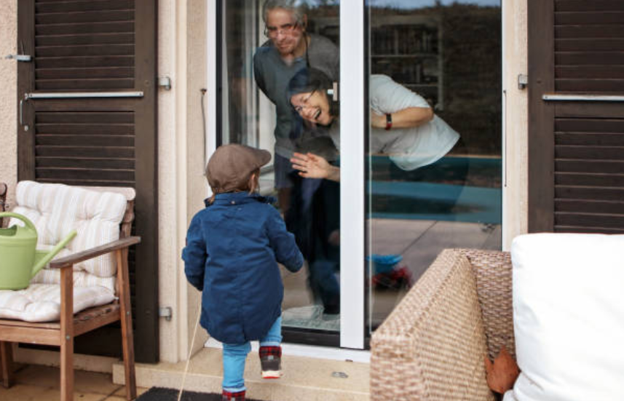
3
How do you feel about it?
Lockdown and social distancing measures which have already been relaxed.
Going to see your grandparents or other people who may be vulnerable.
Delighted!
Happy
Okay
Nervous
Worried
Notes:
Images
iStock
References

Slide 10
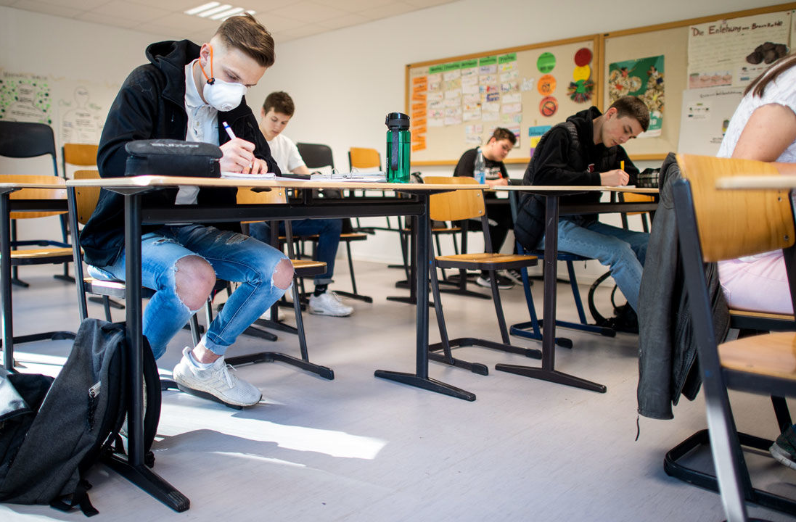
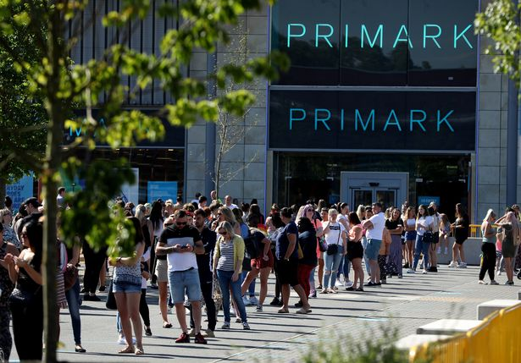
3
How do you feel about it?
Everyone going back to school with social distancing measures in place.
Non-essential shops reopening and the long queues that it is creating.
Delighted!
Happy
Okay
Nervous
Worried
Notes:
Images
iStock
https://www.mirror.co.uk/news/uk-news/primark-shoppers-shamed-queuing-urge-22194173
https://www.sciencemag.org/news/2020/04/reopening-puts-germany-s-much-praised-coronavirus-response-risk
References

Slide 11
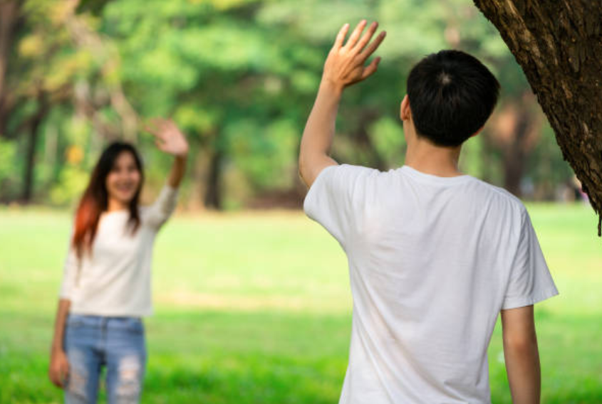
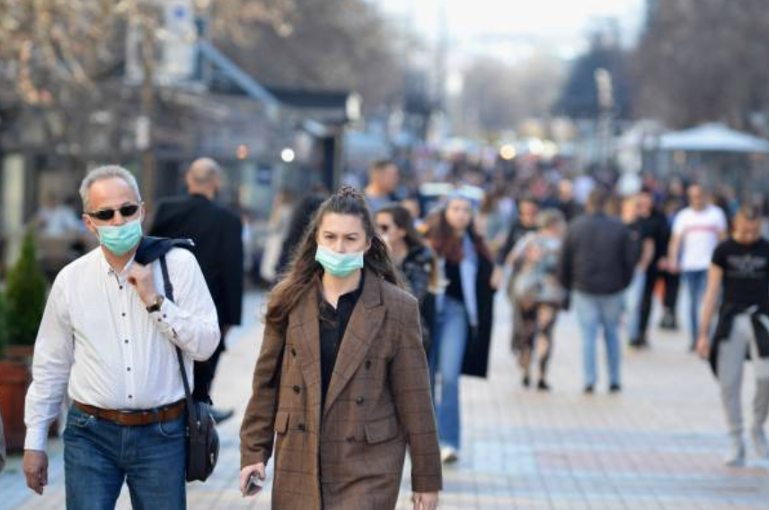
3
How do you feel about it?
Meeting up with your friends in the park/outdoors.
Going to crowded, busy places where social distancing doesn’t work.
Delighted!
Happy
Okay
Nervous
Worried
Notes:
Images
iStock
References

Slide 12
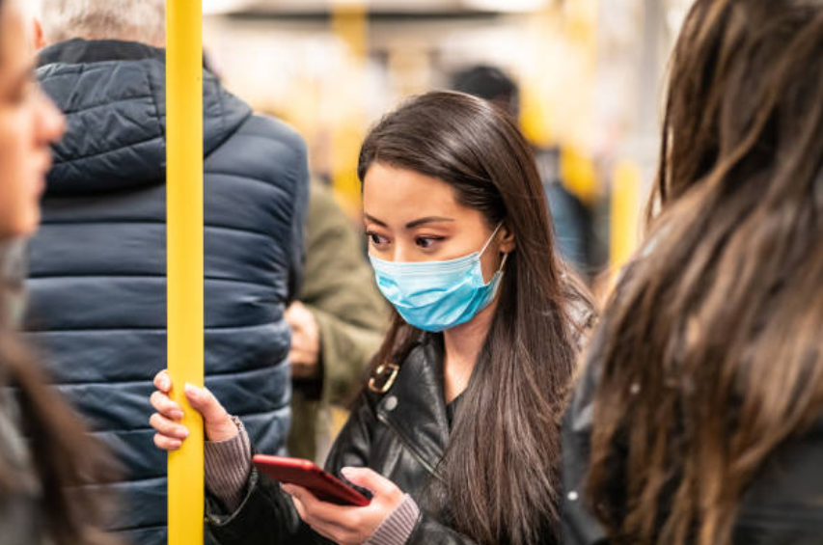
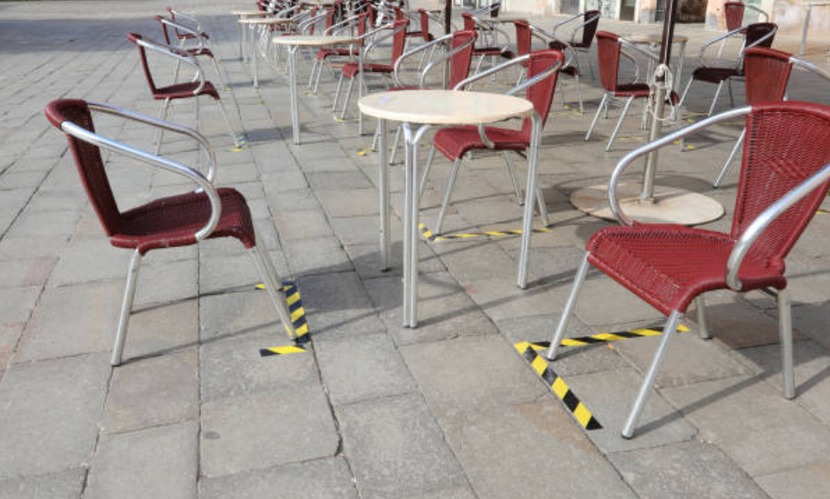
3
How do you feel about it?
Using public transport and having to wear masks in public places.
The future changes to lockdown, such as holidays to other countries and the opening on cinemas and restaurants.
Delighted!
Happy
Okay
Nervous
Worried
Notes:
Images
iStock
References

Slide 13
3
How do you feel about it?
Reflect (2-3 mins)
Overall, how do you feel about the “new normal?”
Delighted!
Happy
Okay
Nervous
Worried
Notes:
Images
iStock
References

Slide 14
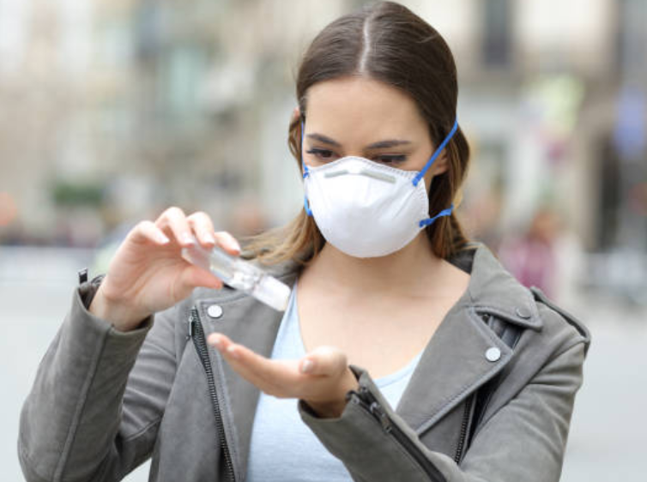
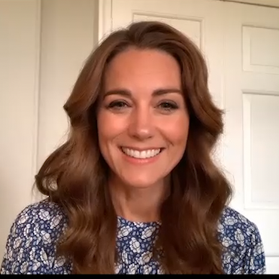
Call to Action
Quick idea
Make sure you’re prepared!
Have you got everything you need for the new normal, like face masks, hand sanitiser and a plan to keep your distance?
0:00-12:22
A royal assembly!
Lockdown, and even leaving lockdown, “has been difficult for us all”. This is what Kate, the Duchess of Cambridge said in her live assembly all about kindness last week. You can watch it by clicking the picture.
Big idea
https://safeshare.tv/x/AI8ox2bX_rQ
Notes:
Alternative video link: https://www.youtube.com/watch?v=AI8ox2bX_rQ

Slide 15
Are you ready for the new normal?
YES
NO
The new rules let us do more things while staying safe and helping to not spread the virus. I’m ready for it!
I’m really bored of social distancing and staying at home. I want to go out and see my friends!
The death rate has dropped, so I think this is the right time to start easing lockdown.
…
I think that the new normal is too risky- social distancing is really hard in places like shops and at school so it might not be safe.
I feel that it’s too soon to be making these changes. We should wait until we’re sure there won’t be a second wave.
I don’t think people will act sensibly with the new freedoms, so it’s not a good idea.
…
Calling all voters!
You can still vote at home! Just follow the link: https://www.surveymonkey.co.uk/r/vfs-secondary-new-normal

Slide 16
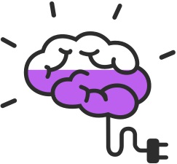
You can vote from home at… https://www.surveymonkey.co.uk/r/vfs-secondary-new-normal
To have your voice heard!
If you have any issues, comments or feedback, click to use the SurveyMonkey link or email aisling@votesforschools.com.

